Slide 1
Intro to School Finance New Board Member Workshop
December 3, 2016
Zane K. Woolstenhulme
Business Administrator
Ogden School District
zanew@ogdensd.org

Slide 2
Discussion Topics
SCHOOL BOARDS AND BUDGETS
SCHOOL FINANCE FUNDAMENTALS
MINIMUM SCHOOL PROGRAM
Q & A

Slide 3
CALENDARS
CALENDAR YEAR (CY)
TAX YEAR (TY)
FISCAL YEAR (FY)
SCHOOL YEAR (SY)

Slide 4
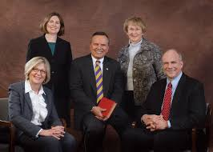
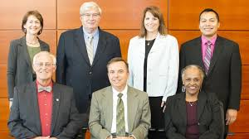
SCHOOL BOARDS AND BUDGETS
Who’s Responsible?
What’s my Responsibility?

Slide 5
SCHOOL BOARDS AND BUDGETS --- Continued
Title 53 A --- Utah Code Annotated --- State System of Public Education
Chapter 3 --- Local School Boards
53A-3-402(2) --- Local school boards shall spend minimum school program funds for programs and activities for which the State Board of Education has established minimum standards or rules under Section 53A-1-402.
53 A-3-402 (3) --- A board may purchase, sell, and make improvements on school sites, buildings, and equipment and construct, erect, and furnish school buildings.
Chapter 19 --- School district and charter school budgets
53A-19-101(2) --- Before June 1 of each year, the budget officer shall prepare a tentative budget, with supporting documentation, to be submitted to the budget officer's governing board.
53A-19-102(2)(a) --- For a school district, before June 22 of each year, a local school board shall adopt a budget and make appropriations for the next fiscal year.

Slide 6
SCHOOL BOARDS AND BUDGETS --- Continued
Who is the “Budget Officer”?
District Superintendent
District Budget Director
Business Administrator
Local Board President

Slide 7
SCHOOL BOARDS AND BUDGETS --- Continued
Role of the Business Administrator in the Budget Process?
53A-3-303 --- Duties of business administrator
assist the superintendent in the preparation and submission of budget documents and statistical and fiscal reports required by law or the State Board of Education;
be custodian of all district funds, be responsible and accountable for all money received and disbursed, and keep accurate records of all revenues received and their sources;
prepare and submit to the board each month a written report of the district's receipts and expenditures;
prepare and submit to the board a detailed annual statement for the period ending June 30, of the revenue and expenditures, including beginning and ending fund balances;
insure that adequate internal controls are in place to safeguard the district's funds.

Slide 8
SCHOOL FINANCE FUNDAMENTALS
WHERE DOES IT COME FROM?
WHERE DOES IT GO?

Slide 9
MOVING TARGET
SCHOOL FINANCE FUNDAMENTALS --- Continued
PRELIMINARY ESTIMATES
MID-YEAR UPDATES
FINAL UPDATES
ENROLLMENTS
YEAR-END AVERAGE DAILY MEMBERSHIP
OCTOBER 1ST

Slide 10
BUCKETS OF FUN(DS)
SCHOOL FINANCE FUNDAMENTALS --- Continued
GENERAL FUND
STUDENT SERVICES FUND
TAX INCREMENT FUND
DEBT SERVICE FUND
CAPITAL PROJECTS FUND
FOOD SERVICES FUND
ENTERPRISE FUND

Slide 11
WHERE DOES IT GO?
SCHOOL FINANCE FUNDAMENTALS --- Continued

Slide 12
WHERE DOES IT GO? --- Another View
SCHOOL FINANCE FUNDAMENTALS --- Continued

Slide 13
WHERE DOES IT COME FROM?
SCHOOL FINANCE FUNDAMENTALS --- Continued

Slide 14
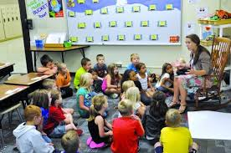
FEDERAL REVENUE
SCHOOL FINANCE FUNDAMENTALS --- Continued
TITLE PROGRAMS
Poverty
Mobility & Homeless
English Language Learners
Quality Teaching / Professional Development
21st Century Schools
IDEA – SPECIAL EDUCATION PROGRAMS
Medicare & Medicaid Reimbursement Programs
FEDERAL IMPACT AID
DIRECT GRANTS

Slide 15
LOCAL REVENUE
SCHOOL FINANCE FUNDAMENTALS --- Continued
PROPERTY TAXES (Taxable Value X Tax Rate)
Basic Levy (Set by State) → .001675 --- Same for all School Districts)
Board Local Levy (Legal Max → .001800 or .002500)
Voted Local Levy (Voter Authorized, Max → .002000)
OTHER SOURCES
Interest Income
School & Activity Fees
Inter-District Billings
Redevelopment Agency (RDA) Payments

Slide 16
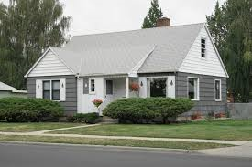
BASIC LEVY HISTORY
SCHOOL FINANCE FUNDAMENTALS --- Continued
FISCAL YEAR | BASIC LEVY
1986-87 | .004256
1994-95 | .004220
1995-96 | .002640
2005-06 | .001720
2009-09 | .001250
2012-13 | .001650
2014-15 | .001419
2015-16 | .001675
BASIC LEVY 1987-Present
<---
What If…???
$200,000
Increase ---$280/yr. or $23 per month
$596,011,346
Source: Office of Legislative Fiscal Analyst

Slide 18
STATE REVENUE
SCHOOL FINANCE FUNDAMENTALS --- Continued
STATE INCOME TAX (Primary Source)
SCHOOL LAND TRUST (INTEREST & DIVIDENDS)
OTHER
STATE EDUCATION FUND
$ 3.75 Billion --- FY2017

Slide 19
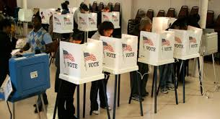
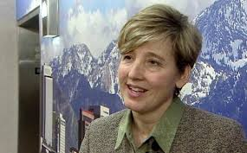
Constitutional Amendment
SCHOOL FINANCE FUNDAMENTALS --- Continued
“Utah voters passed a ballot measure that enabled legislators to use income tax dollars for higher education. This, combined with the use of sales tax earmarks for roads, started the complex practice of robbing Peter to pay Paul.”
Natalie Gochnour (Deseret News Op Ed: Oct 3, 2014)
Associate Dean, David Eccles School of Business, U of U; Chief Economist, Salt Lake Chamber

Slide 20
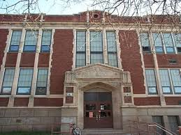
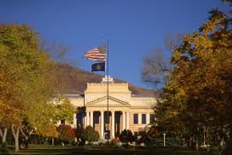
WHAT CHANGED?
SCHOOL FINANCE FUNDAMENTALS --- Continued
Education Fund (Income Tax)
General Fund (Sales Tax)
Public Education
Higher Education
Transportation

Slide 21
EDUCATION FUND
SCHOOL FINANCE FUNDAMENTALS --- Continued
YEAR | Public Education | % | Higher Education & Other Agencies | %
1995 | $1.12 Billion | 98% | $ 18 Million | 2 %
2000 | $ 1.56 Billion | 88% | $ 212 Million | 12%
2005 | $ 1.81 Billion | 86% | $ 288 Million | 14 %
2008 | $ 2.6 Billion | 72% | $ 1 Billion | 28 %
2013 | $ 2.66 Billion | 83% | $ 563 Million | 17%
2017 | $ 3 Billion | 82% | $ 662 Million | 18 %
Source: Appropriations Reports, Office of Legislative Fiscal Analyst

Slide 22
SCHOOL FINANCE FUNDAMENTALS --- Continued
“In fiscal year 2015, the state spent $630 million from the education fund for higher education, $432 million in general fund for higher education, and $458 million in sales tax earmarks for transportation. The budget buckets have become completely co-mingled.”
Natalie Gochnour – Continued… (Deseret News Op Ed: Oct 3, 2014)
Associate Dean, David Eccles School of Business, U of U; Chief Economist, Salt Lake Chamber

Slide 23
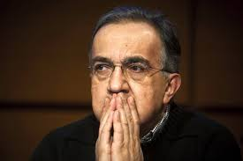
STATE FUNDING
SCHOOL FINANCE FUNDAMENTALS --- Continued
How Does The Money Flow ?
Funding Distribution?

Slide 24
MINIMUM SCHOOL PROGRAM (MSP)
Primary funding source for school districts and charter schools in Utah. The Fiscal Year (FY) 2017 total budget is $3,844,894,400, including State & Local Revenue
Used to support over 1,000 traditional, alternative, special education and charter schools for about 650,000 Utah students.
Distributed according to formulas provided by State Law and State Board Rules.

Slide 25
Weighted Pupil Unit
Minimum School Program --- Continued
PRIMARY DISTRIBUTION UNIT WITHIN MSP
180 DAYS OF MEMBERSHIP ONE WPU
(Membership Driven not Attendance Driven)

Slide 26
FY17 WPU VALUE
Minimum School Program --- Continued
$ 3,184
1 % Increase in the WPU costs about $30 Million

Slide 27
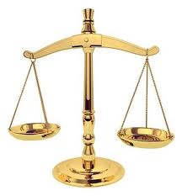
WPU WEIGHTING
Minimum School Program --- Continued
SCHOOL DISTRICT STUDENTS
CHARTER SCHOOL STUDENTS
Kindergarten Students --- 55%
Grades One thru 12 ---- 100%
Kindergarten Students --- 55%
Grades One thru Six ---- 90%
Grades Seven & Eight ----- 99%
Grades Nine thru 12 ---- 120%

Slide 28
WPU HISTORY
Minimum School Program--- Continued
WPU Value
FISCAL YEAR | WPU VALUE | CPI Adjusted
1986-87 | $1,204 | $2,656
1994-95 | $1,608 | $2,623
2000-01 | $2,006 | $2,816
2006-07 | $2,417 | $2,898
2008-09 | $2,577 | $2,893
2011-12 | $2,816 | $3,026
2016-17 | $3,184 | $3,184
CPI Adjusted WPU Value
Change: $ 1,980 $ 528
Source: Bureau of Labor Statistics

Slide 30
Minimum School Programs
Minimum School Program --- Continued
Basic School Programs
Regular
Restricted
Related to Basic School Programs
Board and Voted Local Levy Programs
School Building Programs (Funded Separately from MSP)

Slide 31
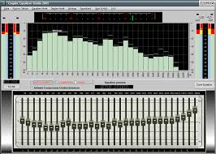
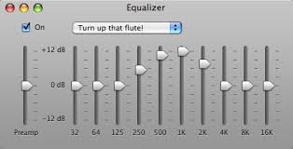
MSP ---- The Equalizer
Minimum School Program --- Continued
DISTRICT | ALPINE | SALT LAKE | PARK CITY | SOUTH SANPETE | Morgan
BASIC SCHOOL PROGRAMS Allocation | $261,651,891 | $ 89,430,154 | $ 17,054,766 | $ 13,516,830 | $ 9,603,534
Actual Locally Funded (FY 14 Basic Rate →.001535) | $ 25,446,597 | $ 27,479,103 | $ 17,054,766 | $ 863,974 | $ 1,430,914
MSP STATE FUNDED | $236,205,294 | $ 61,951,051 | N/A | $ 12,652,856 | $ 8,172,620
Percent State Funded | 90% | 69% | Zero | 95% | 85%
Average All Districts – 85%
Source: USOE -- FY14 Final Summaries

Slide 32
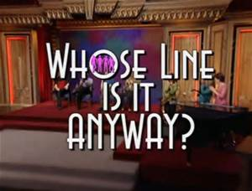
Minimum School Program --- Continued
The Infamous “LINE”

Slide 33
Minimum School Programs
Minimum School Program --- Continued
Basic School Programs (WPU Driven)
Related to Basic School Programs
Board and Voted Local Levy Programs
School Building Programs (Funded Separately from MSP)
T H E “L I N E”

Slide 34
Minimum School Program --- Continued
Basic School Programs
(WPU DRIVEN FUNDING)
ABOVE
The “LINE”
BELOW
Related to Basic School Programs (Non-WPU Formula Driven Funding)

Slide 35
Basic School Programs –Regular (Above the Line)
Minimum School Program --- Continued
Kindergarten (27,529 WPUs, $87.6 Million)
Grades 1-12 (576,694 WPUs, $1.84 Billion)
Necessarily Existent Small Schools (9,514 WPUs, $30.3 Million)
Professional Staff Cost (55,577 WPUs, $177 Million)
Administrative Costs (1,490 WPUs, $4.7 Million)
Per MSP Preliminary Estimates FY17 --- USBE

Slide 36
Basic School Programs – Restricted (Above the Line)
Minimum School Program --- Continued
Special Education Programs (105,443 WPUs, $335.7 Million)
Career & Technology Education – Add On (28,050 WPU’s, $89.3 Million)
Class Size Reduction (39,990 WPUs, $127.3 Million) Note: Based on the average teacher’s salary --- 1,700 teachers state-wide.

Slide 37
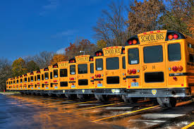
Related to Basic Programs (Below the Line)
Minimum School Program --- Continued
To and From School → Pupil Transportation → $79 Million
68% -vs- 85% → $21 Million
Guarantee Transportation Levy → $500K
Flexible Allocation Distribution → $7.8 Million

Slide 38
Related to Basic Programs (Continued)
Minimum School Program --- Continued
Special Populations – (Major Programs)
Enhancement for At-Risk Students → ($26.5 Million)
Youth in Custody → ($21.5 Million)
Adult Education → ($10.6 Million)
Enhancement for Accelerated Students → ($4.7 Million)
Concurrent Enrollment →($10.2 Million)

Slide 39
Related to Basic Programs (Continued)
Minimum School Program --- Continued
Other Programs
School Land Trust Program → ($45 Million)
Charter School Local Replacement → ($129 Million)
Charter School Administrative Costs → ($7.5 Million)
K-3 Reading Improvement Program → ($15 Million)
Educator Salary Adjustment → ($167 Million)
Teacher Salary Supplement Restrict Account → ($6.8 Million)
Library Books & Electronic Resources → ($850 K)
Matching Fund for School Nurses → ($1 Million)
Critical Languages & Dual Immersion → ($3 Million)
Year-Round Math & Science (USTAR Centers) → ($6.2 Million)
Early Intervention → ($ 7.5 Million)
Beverly Taylor Sorenson Arts Learning Program → ($8.8 Million)
Digital Teaching & Learning Program → ($9.8 Million)
Notes:
The School Land Trust Program was established by the legislature in 1999 and distributes the “annual dividend” from the permanent State School Fund through school districts to all public schools (including charter schools in the state)
FY01 --- $4.9 Million
Now --- $37.44 Million

Slide 40
Related to Basic Programs (Continued)
Minimum School Program --- Continued
One-Time Funding Items
Teacher Supplies & Materials → ($6 Million)
Beverly Taylor Sorenson Arts Learning Program → ($750 K)
Special Ed Intensive Services →($1 Million)
Digital Teaching and Learning Programs →($3.8 Million)

Slide 41
VOTED AND BOARD LOCAL LEVY PROGRAMS
*** Guarantee Rate (per 0.0001 Tax Rate per WPU) → $38.54
Voted Local Levy Program → $427,474 Million *** (Up to .001600 Tax Rate)
Board Local Levy Program → $128,191 Million *** (Up to .000400 Tax Rate)
Board Local Levy – Reading Improvement Program → $15 Million

Slide 42
Voted & Board Levy Guarantee
DISTRICT | CACHE | NEBO | PARK CITY | PROVO | SOUTH SANPETE
Voted and Board Levy Program | $ 17,446,338 | $ 28,170,900 | $ 23,175,250 | $ 15,449,929 | $ 3,396,372
LOCAL TAX RATE (EFFORT) | .002430 | .002932 | .002341 | .002444 | .003381
Local Tax Rate Funded | $ 8,386,524 | $ 11,780,129 | $ 23,175,250 | $ 8,659,747 | $ 1,149,670
MSP STATE FUNDED | $ 9,059,864 | $ 16,390,771 | N/A | $ 6,790,180 | $ 2,246,702
Percent State Funded | 52% | 58% | N/A | 44% | 66%
Return On Tax Effort | 1.08 | 1.39 | N/A | .78 | 1.95
25 Districts Participating
Source: USBE -- FY17 Preliminary Estimates

Slide 43
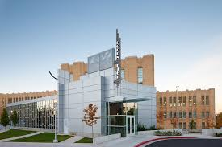
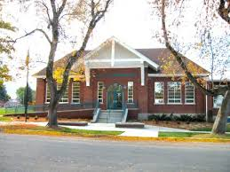
School Building Programs
Capital Outlay Programs (Reference: Utah Code 53A-21-101,201,301)
Foundation → ($27.6 Million) Based on local property tax effort and tax yield per student based on a foundation guaranteed funding level. (14 Districts)
2. Enrollment Growth →($5.6 Million) Provides funding to school districts experiencing net enrollment increases. (17 Districts)

Slide 44
QUESTIONS ???

Slide 45
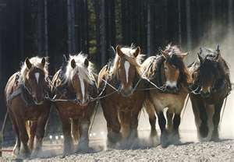
Pulling Together, Great Things Can Happen !!!

