Slide 1
School Finance 202
January 7, 2017
Richard Reese, CPA
Business Administrator
Murray City School District
rreese@murrayschools.org

Slide 2
Discussion Topics
State Funding Per Pupil
Understanding Basic Audited Financial Statements
Bonding and Bond Ratings
Community Reinvestment Agencies
Q & A

Slide 3
State Funding Per Pupil – FY2008 vs. FY2017

Slide 5
Understanding Audit of Basic Financial Statements

Slide 6
Types of Audits
Internal Audit
Audits performed by school district staff.
Senate Bill 93, 2014 Session, requires that a local education agency (LEA) with more than 10,000 students have an internal audit program.
Internal audit is defined as “an independent appraisal activity established within a LEA as a control system to examine and evaluate the adequacy and effectiveness of other internal control systems within the LEA.”
External Audit
Audit performed annually by an entity that is independent of the school district

Slide 7
Roles of the Independent Auditor
Audit and provide audit opinions on:
Basic Financial Statements
Government-wide Financial Statements
Fund Financial Statements
Notes to the Basic Financial Statements
Federal Programs Audit “Single Audit”
Auditor must test at least 20% of Federal Funds
Audit based on risk factors as dictated by the Federal Audit Guide
State Compliance Audit
Requirements published by the Utah State Auditor’s Office

Slide 8
Roles of the Independent Auditor - Continued
There are four types of audit opinions:
Unmodified Opinion
When the auditor concludes that the financial statements are presented fairly, in all material respects, in accordance with the applicable financial reporting framework.
Qualified Opinion
Misstatements, individually or in the aggregate, are material but not pervasive to the financial statements
Adverse Opinion
Misstatements, individually or in the aggregate, are both material and pervasive to the financial statements
Disclaimer of Opinion
Auditor is unable to obtain sufficient appropriate audit evidence on which to base an opinion
Auditor concludes that undetected misstatements, if any, could be both material and pervasive

Slide 9
Basic Financial Statements – What to Look For
Four Main Areas
Management Discussion and Analysis – MD&A
Government-wide Financial Statements
Fund Financial Statements
Notes to the Basic Financial Statements

Slide 10
Basic Financial Statements – What to Look For (Cont.)
Management Discussion and Analysis – MD&A (Definitely Review)
Typically Written by Management
Financial Highlights
Overview of Financial Statements
Government-wide Financial Analysis
Fund Financial Analysis

Slide 11
Basic Financial Statements – What to Look For (Cont.)
Government-wide Financial Statements (Review if Nothing Better to Do)
Designed to provide a broad overview of the District’s finances, in a manner similar to a private-sector business
Includes Statement of Net Position and Statement of Activities

Slide 12
Basic Financial Statements – What to Look For (Cont.)
Fund Financial Statements (Absolutely Review)
Balance Sheet for all Governmental Funds
Statement of Revenues, Expenditures, and Changes in Fund Balance for all Governmental Funds
Reconciliation of Balance Sheet to Statement of Net Position
Reconciliation of Revenues, Expenditures, and Changes in Fund Balances to Statement of Activities

Slide 13
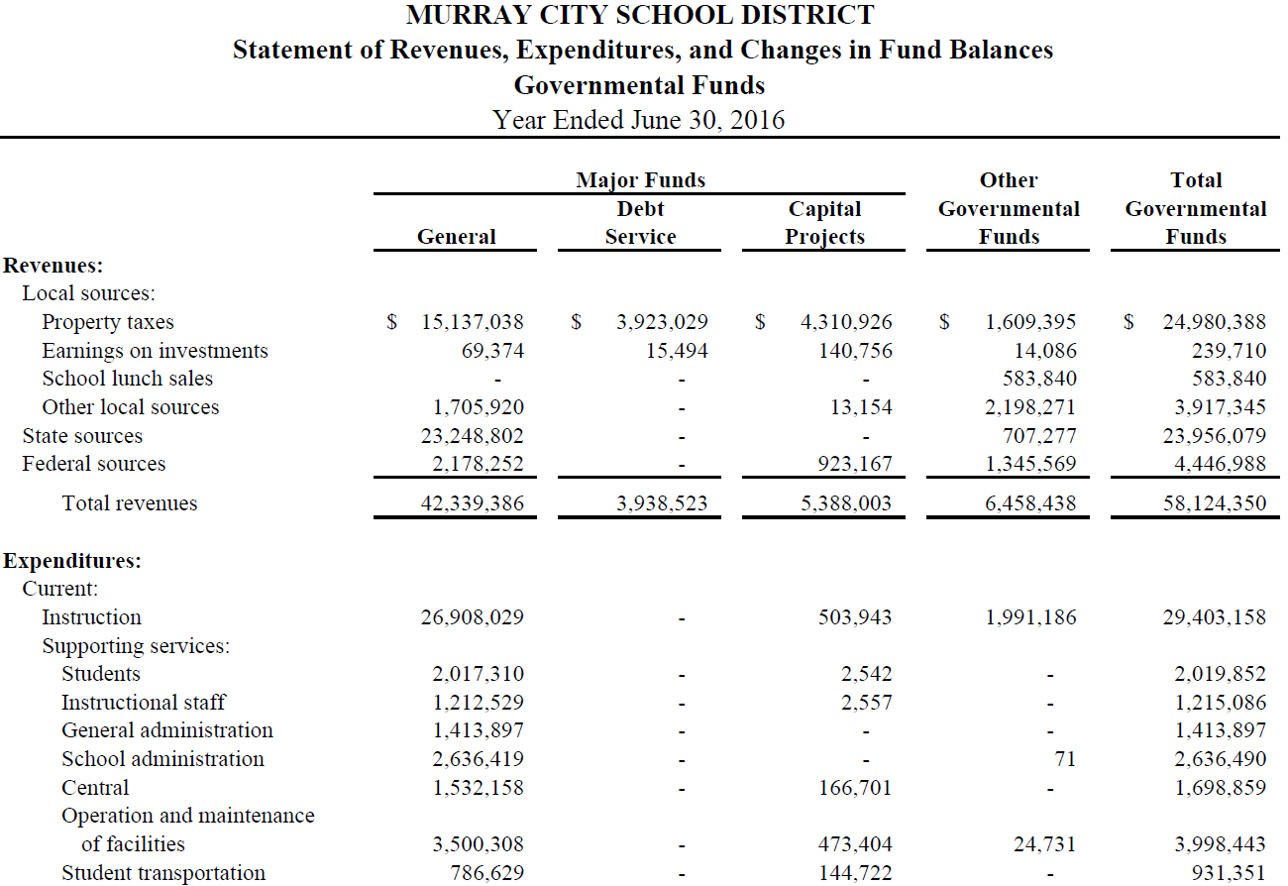

Slide 14
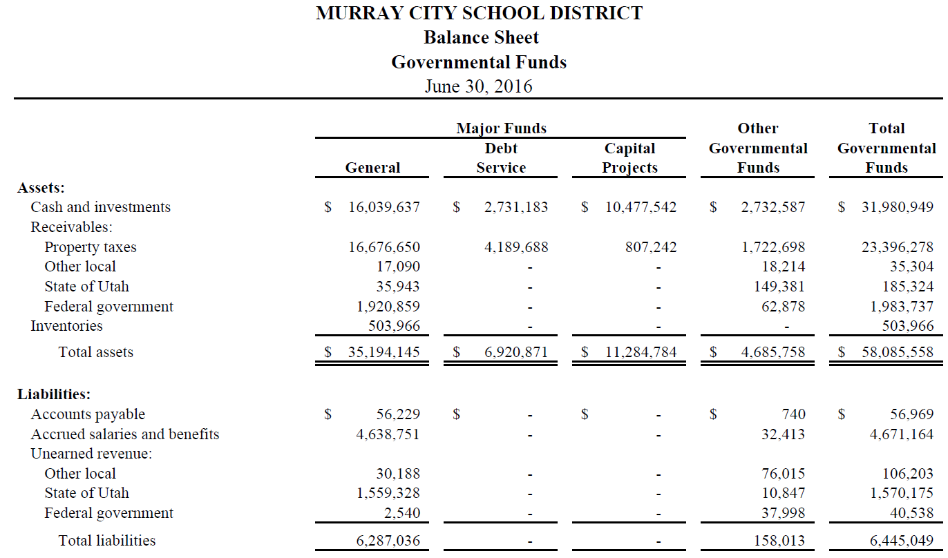
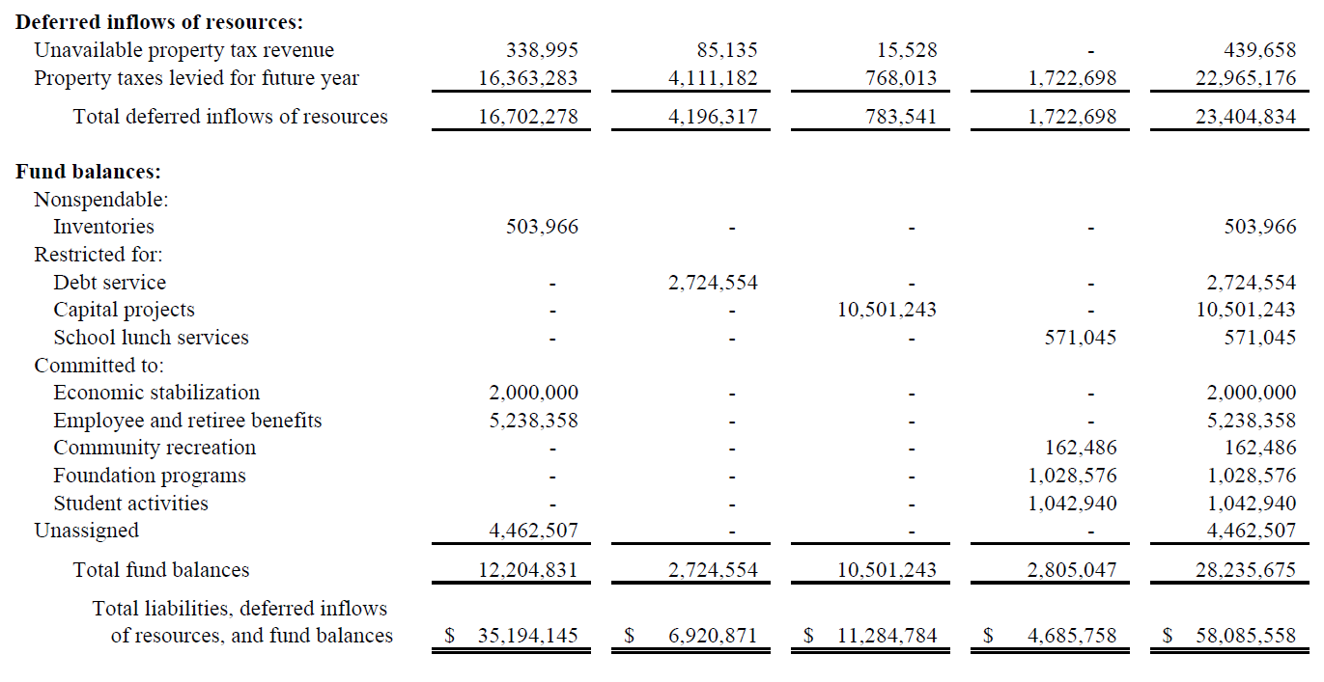

Slide 15
Basic Financial Statements – What to Look For (Cont.)
Notes to Basic Financial Statements (Should Review)
Provides detailed information on:
Significant Accounting Policies
Deposits and Investments
Fair Value Measurement
Property Taxes
Capital Assets
State Retirement Plans
Risk Management
Long-Term Liabilities
Other Postemployment Benefits
Litigation and Legal Compliance
Grants

Slide 16
Bonding and Bond Ratings

Slide 17
What Types of Bonds Are There?
General Obligation Bonds
Most common type of bonds issued by school districts
Requires voter approval
Allows school district to raise the debt service tax rate necessary to pay debt obligations
The best debt mechanism for taxpayers, will yield the lowest overall cost
The debt service tax rate is not included in the certified tax rate process
Lease Revenue Bonds
Does not require voter approval
Capital improvement/land used as collateral to secure debt
Debt payments made from capital or general funds
Issued by school board acting as a Local Building Authority (LBA)
LBA issues bonds and leases asset to the school district
Tax Credit Bonds
Qualified School Construction Bonds (QSCBS) or Quality Zone Academy Bonds (QZABS)
School Districts typically pay principal only, generally 12 year payback period
Interest paid directly by Federal government to investor or offered as a tax credit
Does not require voter approval

Slide 18
What is a Bond Rating ?
A bond rating is an opinion of the credit worthiness of a bond issuer in general, as well as risk associated with a particular debt security
Ratings are given to a school district’s bonds, not to the school district itself
There is a high correlation between credit quality and the probability of default. In other words, the higher the rating, the lower the probability of default

Slide 19
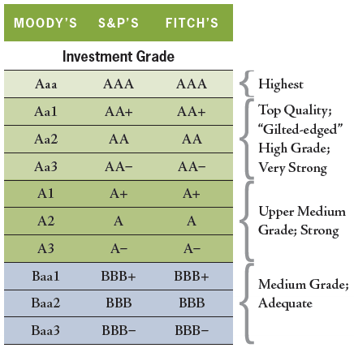
Bond Ratings

Slide 20
Standard & Poor’s G.O. Bond Rating Criteria
Economy
Income levels as a % of national average
Market value per capita
Taxpayer concentration
Debt
Debt to market value
Debt service to operating expenditures
Overall debt per capita
Debt to annual income
Appropriate debt amortization
Finances
Ending general fund balance as a % of operating revenues
Unassigned general fund balances
Property tax burdens
Governance/Management
Best practices
Worst practices

Slide 21
Utah School Bond Guaranty Program
The School Bond Guarantee Program provides credit enhancement to voter-approved general obligation (GO) bonds issued by school districts
The program provides savings to taxpayers by pledging the full faith and credit of the State to the payment of voter-approved school district GO bonds
This provides the qualifying school district bonds with the State’s strong credit rating of AAA
The higher the school district bond rating the lower the interest rate, even with the state guarantee

Slide 22
Utah School Bond Guaranty Program – Cont.
What impact does Utah School Bond Guaranty Program have on the school district’s underlying bond rating?
On a recent bond issue by Washington School District there was, on average, a 10 bps savings on interest rates

Slide 23
Utah School Bond Guaranty Program – Cont.
What is the financial impact of that 10 bps difference?
$20 million bond issue for 20 years - $250,000
$40 million bond issue for 20 years - $500,000
$100 million bond issue for 20 years - $1.2 million

Slide 24
General Information
What rating agencies should you use?
Moody’s – if just one rating (most common for Utah school districts)
Split opinions – At least Moody’s and S&P, Fitch as a second rating or any two
How many ratings do you need?
Under $40 million, just one rating
Over $40 million, two ratings

Slide 25
Rating Agency Fees

Slide 26
Ratings Surveillance
Once a bond receives a rating and is issued, the bond rating stays with it until maturity
Rating agencies are constantly reviewing ratings to see if anything material has occurred to move the rating
Bond ratings can move up or down at any time
The school district might be asked to participate in a rating surveillance call with a rating analyst – typically every two years

Slide 27
When Do You Issue Bonds Without a Rating?
Private Placements
Size – Bonds are so small, the costs of issuance outweigh the lower borrowing rate from market issuance
Tax Credit Bonds (QZABs and QSCBs) – limited number of investors in the public market, or rates are not that different

Slide 28
What Can a School Board Do?
Have a plan and execute it
Does the district have a written plan or goal for maintaining fund balances at a certain level?
Be consistent
Be proactive in addressing future issues/problems
Example – In 2015, Chicago Public Schools borrowed $634 million to make required pension payments and laid off 1,400 employees, after they had made $940 million in budget cuts in the previous four years
Make the difficult decisions
How did districts respond to the recession in 2008-09?
Are decisions sustainable in the long-term?

Slide 29
Community Reinvestment Agencies

Slide 30
What is a Community Reinvestment Agency (CRA)?
A government body created to promote urban renewal, economic development, or community development
A CRA creates a property tax revenue stream to encourage this new development through tax increment financing (TIF)
Prior to new 2016 legislation “Community Reinvestment Agency Act” known as:
Redevelopment Agencies
Economic Development Agencies
Community Development Agencies

Slide 31
Are CRA’s Good for School Districts?
It Depends!
The Real Question to be asked is:
BUT FOR the CRA, would the development occur anyway?

Slide 32
What Projects Could Be Appropriate Under a Community Reinvestment Agency (CRA)?
Blight Reduction Projects – Probably
Urban Renewal – Probably
Community Development – Maybe
If the community development is residential I would not approve
Economic Development – Maybe
Retail Development – Probably Not
Retail business follows demographics
If the population is there, retail will follow

Slide 33
What Are Some Requirements of a Community Reinvestment Agency (CRA)?
Written Budget
Predictions for the project area
Financial Details about the project area
Agency’s Expected Activities
For a fixed period
Single Annual Report - November
To receive funds the Agency can choose between:
Creating a taxing entity committee – necessary to eliminate blight situations or using eminent domain
Entering into interlocal agreements with individual taxing entities
Housing Allocation - Mandatory
10% of budget for normal CRA’s
20% of budget for CRA’s with eminent domain (TEC can reduce to 10%)

Slide 34
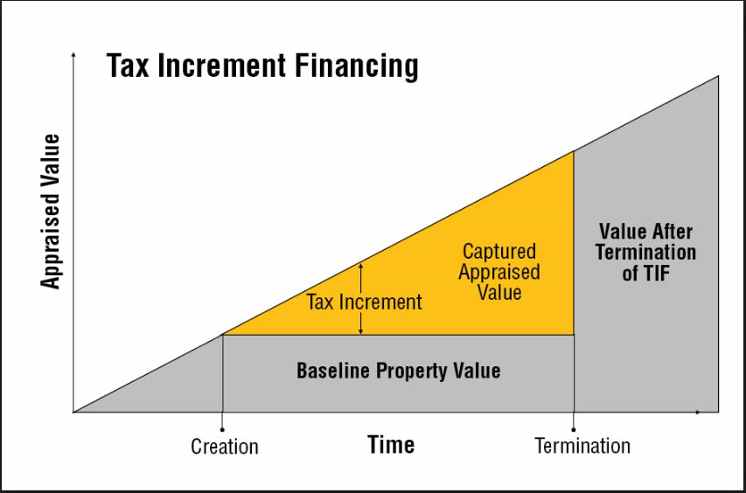
How Does TIF Work?

Slide 35
How Does TIF Work - Continued?
Property taxes are collected from projects/developments in the CRA
In Salt Lake County, taxes are sent to the CRA in December and May
Those taxes are then distributed to entities in the CRA based on written agreements
A School District can often negotiate a “mitigation payment” from the CRA

Slide 36
What Taxing Entities Participate in a CRA?
School District – Typically 50% to 65% of local taxes collected
City
County
Special Taxing Districts
Library
Mosquito Abatement
Fire
Water District
Etc.

Slide 37
What Does a CRA Taxing Entity Committee Look Like?
A total of 8 Voting Members:
School District – 2 voting members
City – 2 voting members
County – 2 voting members
Special Taxing Districts – 1 voting member
Utah School Board of Education – 1 voting member

Slide 38
If a CRA is Approved – What School Districts Are Affected?
If development would have occurred without the CRA, every school district in the state!
Why? Because statewide Basic Tax Rate Collections are lower than they would have been without the CRA. That means less money in the Uniform School Fund is distributed to all school districts.

Slide 39
If a CRA is Approved – What School Districts Are Affected? Continued
Estimated Statewide CRA Tax Increment for FY18 is $14.557 billion
Impact on Basic Rate Tax Collection - $24.675 million or almost 1% on the WPU
Impact on Local Tax Rate Collection (Less Basic/Debt) - $59.293 million
Source: USBE

Slide 40
CRA Conclusion
To be clear…..not all CRAs are a bad thing
Approving a CRA is a local decision. Only the taxes from growth are affected
The school district is not actually “losing” funds if the project would not have taken place without the CRA….back to the BUT FOR question
Some CRAs can prove beneficial in the long run
CRAs allow for more negotiation than in previous law. Make sure all taxing entities have skin in the game and that school districts are not bearing most of the burden

Slide 41
QUESTIONS?

