Slide 1
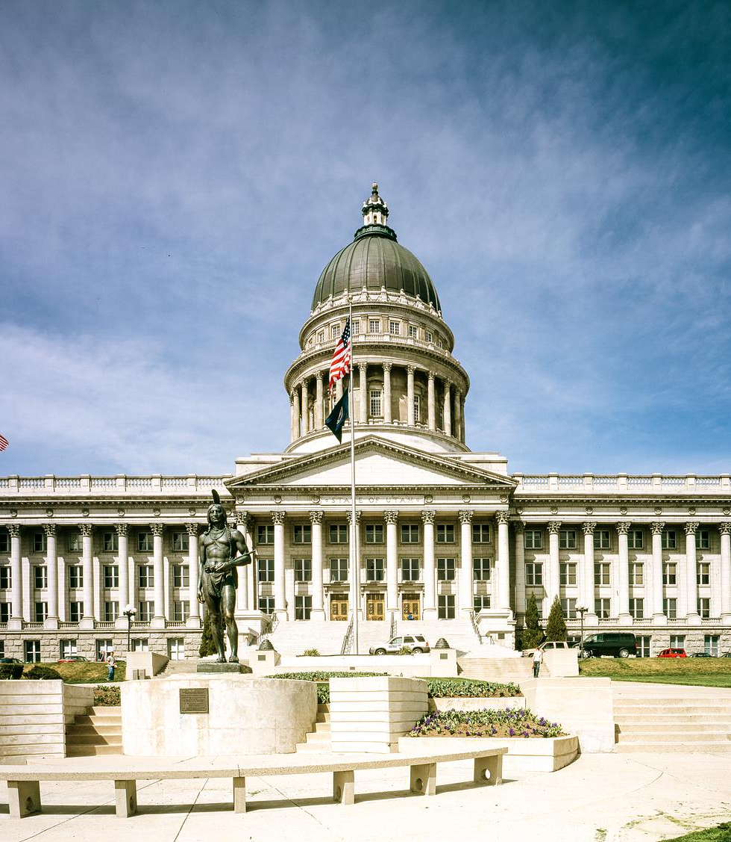
USBA Spring Regional Meeting
March 2026

Slide 2
Agenda
Welcome & Introductions
Dinner
2026 Legislative Session
Looking Forward - 2027
Closing Remarks

Slide 3
Thank You!!
Everything in leadership is simple, it’s just that the simplest things are difficult. (William McRaven)

Slide 4
Push
Pause
Year | Numbered Bills | Bills Passed | Total Ed Bills
2023 | 929 | 575 | 268
2024 | 934 | 591 | 271
2025 | 959 | 583 | 238
2026 | 1014 | 541 | 213

Slide 5
Session Highlights
1014 bills and resolutions numbered by the Utah Legislature
541 bills were passed by the legislature this session
$25M to at-risk funding
4.2% increase to the WPU = $191.4 M

Slide 6
JLC Highlights
JLC took positions on 98 bills – Supported 42, Opposed 33, & No Position on 23
62% of the bills JLC supported passed during the session
82% of the bills JLC opposed were defeated during the session
Returned to the Capitol for JLC. Had record number of members attend in person & online

Slide 7
JLC Priority Review
Priority
Establish an education working group | Working group established during interims – will continue to meet this year
2% above the guaranteed WPU | Not funded
At-risk funding | $25M in on-going funding
85% of ESA funding to LEAs | HB521 discussions will continue – Education Endowment
Educational funding framework | Hope to discuss in working group and/or HB521 discussions

Slide 8

Funding Overview
WPU Value | $4674 to $4870 4.2% increase
At Risk | $25M on-going
Literacy | $25.6M on-going
APEX | $35M one-time
School Fees (reinstated dollars) | $17.8M
Open Ed | $12M
Dyslexia | $3.5M
Grow Your Own Educator (SPED) | $5M

Slide 9
Session Highlights – Bills Passed
HB273: Classroom Technology Amendments (Defay)
SB69: School Devise Revisions (Fillmore)
SB164: School Construction Amendments (Wilson)
SB241: Early Literacy (Millner)
SB267: Software in Education Amendments (Cullimore)

Slide 10

Session Highlights – Bills Failed
HB170: School Board Referendum Amendments (Shipp)
HB241: Charter School Amendments (Pierucci)
HB440: School Lunch Amendments (Auxier)
HB524: Public Education Financial Officers (Walter)
This Photo by Unknown Author is licensed under CC BY-SA-NC

Slide 11
Looking Forward
Economic Stabilization – Interim Working Group
Civics – Interim Working Group
Superintendent Salaries – Interim Working Group
Business Administrators – Bill will return. Invited bill sponsor to USSA’s April meeting.
School Safety – Threat Assessments

Slide 12

We want to hear from you.

Slide 13
Save the Dates
JLC Meeting – April 17th, 10-12, Nebo Board Room
JLC Meeting – May 15th, 10-12, USBA Office
Pre-Delegate and Delegate Assembly - June 5th and 6th, Canyons Professional Development Center
2027 USBA Day on the Hill – January 22, 2027

Slide 14
Questions

