Slide 1

School Finance Fundamentals
“Making Sense of it All”
USBA Leadership Academy
September 9, 2011

Slide 2
DISCUSSION TOPICS
BUDGET BASICS
MINIMUM SCHOOL PROGRAM
SCHOOL DISTRICT TAXATION

Slide 3
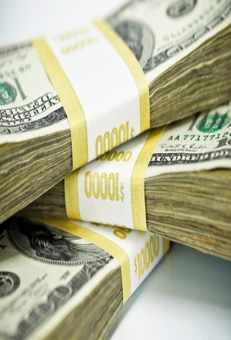
BUDGET BASICS
BUCKETS OF FUN(ds)
Revenue Sources --- Where does all the money come from?
EXPENDITURES -- Where does all the money go?

Slide 4
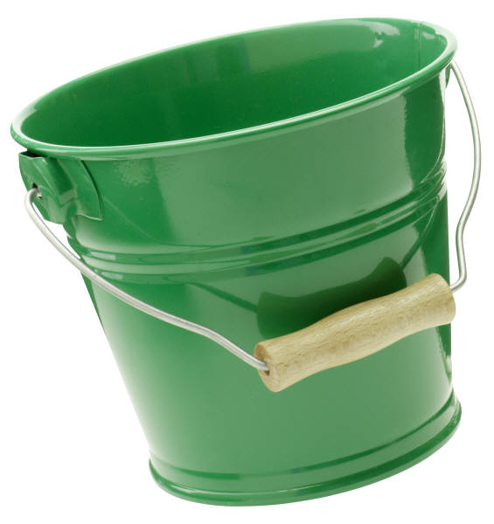
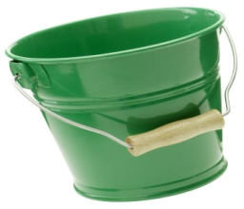

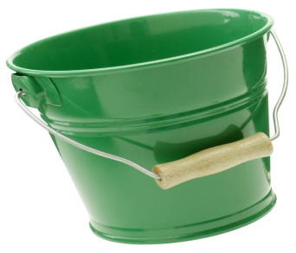
BUCKETS OF FUN(ds)
MAINTENANCE & OPERATIONS ==➔➔
NON K-12 ==➔ =>
DEBT SERVICE ===➔
CAPITAL OUTLAY===➔➔➔
FOOD SERVICES ==➔

Slide 5
REVENUE SOURCES

Slide 6

LOCAL REVENUE
PROPERTY TAXES
INTEREST INCOME
SCHOOL & ACTIVITY FEES
INTER-DISTRICT BILLINGS
SCHOOL LUNCH SALES
COMMUNITY EDUCATION PROGRAMS
REDEVELOPMENT AGENCY (RDA) PAYMENTS

Slide 7

STATE REVENUE
MINIMUM SCHOOL PROGRAM
    EDUCATION FUND
      UNIFORM SCHOOL FUND
      STATE INCOME TAX
      CORPORATE TAXES
SCHOOL LUNCH & DRIVER EDUCATION PROGRAMS
    TAXES ON ALCOHOL SALES & DUI’s

Slide 8

FEDERAL REVENUE
NCLB – NO CHILD LEFT BEHIND
    TITLE 1 PROGRAMS – POVERTY, MOBILITY, ESL
    TITLE 2 PROGRAMS – QUALITY TEACHING/TRAINING
IDEA – SPECIAL EDUCATION PROGRAMS
SCHOOL LUNCH PROGRAMS
American Recovery and Reinvestment Act (ARRA)
EDUJOBS

Slide 9

EXPENDITURES
SALARY & BENEFITS
    (UP TO 90% OF GENERAL FUND)
PROFESSIONAL SERVICES
INSTRUCTIONAL SUPPLIES
TEXTBOOKS & LIBRARY BOOKS
INSTRUCTIONAL EQUIPMENT

Slide 10
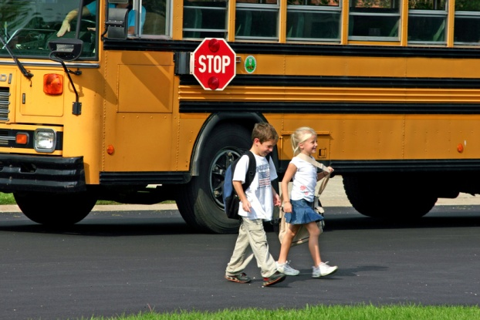
OTHER EXPENDITURES
PUPIL TRANSPORTATION SERVICES
    (TO & FROM CURRENTLY FUNDED AT ABOUT 60% OF COST)
FACILITY MAINTENANCE & REPAIRS
DEBT SERVICE (BOND PAYMENTS)
CAPITAL IMPROVEMENTS & NEW SCHOOLS
CAPITAL EQUIPMENT
FOOD SERVICES
COMMUNITY RECREATION / ATHLETICS
PRESCHOOL PROGRAMS
ADULT EDUCATION

Slide 11
MINIMUM SCHOOL PROGRAM
WEIGHTED PUPIL UNIT (WPU)
CURRENT VALUE = $2,816
(Except for Special Ed Add-On and CTE@ $2,577)
Based on Average Daily Membership
1 student for 180 days = 1 WPU (Grades 1 thru 12)
Kindergarten Students generate @ 55%

Slide 12

WPU HISTORY
YEAR | WPU VALUE
1988 | $1,204
1995 | $1,608
2000 | $2,006
2005 | $2,182
2009 | $2,577
2012 | $2,816

Slide 13
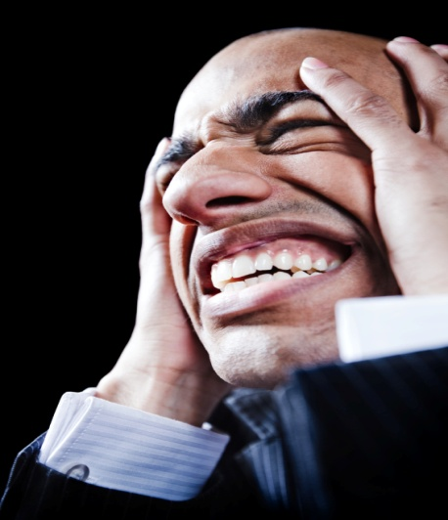
The Infamous “LINE”
Basic School Program:
    WPU Driven Programs (K-12, Sp.Ed, CTE, Others)
Related to Basic: (Transportation)
Special Populations: (At-Risk, Accelerated Programs)
Other Programs: (10 Line Items)
One-time Funding Items (4 Line Items)
Voted Leeway Programs
T H E L I N E

Slide 14

What are all these Programs?
Can we rob Peter to pay Paul?

Slide 15

SORRY!
Your Business Administrator Isn’t Kidding!!

Slide 16

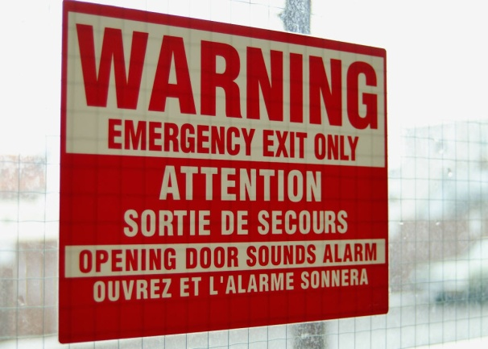
Things Are Not Always As They Appear!

Slide 17

Did the WPU Really Increase ??
You’ve Got to Be Kidding Me!

Slide 19
School District Taxation
ASSESSED VALUTION
TAX RATES --- TAX EFFORT
CERTIFIED TAX RATE
LOCAL CONTROL --- “OR NOT”

Slide 20
ASSESSED VALUATION
THE SUM OF THE TAXABLE VALUE OF ALL PROPERTIES WITHIN THE JURISTICTION
Based on Fair Market Value (FMV)
    Primary Residences Taxed @ 55%
    Second Homes Taxed @ 100%
    Commercial Property Taxed @ 100%

Slide 22
TAX RATES

Slide 23
TAX RATES BY FUND –FY12
FUND (BUCKET) | LEVY DESCRIPTION | STATUTORY LIMIT
GENERAL | STATE BASIC RATE | .001591
GENERAL | VOTED LEEWAY | .001600
GENERAL | BOARD LEEWAY | .000400
GENERAL | READING LEEWAY | .000121
GENERAL | TRANSPORTATION | .000300
GENERAL | TORT LIABILITY | .000100
GENERAL | 10 % OF BASIC | FORMULA
CAPITAL OUTLAY | 10 % OF BASIC | FORMULA
NON-K12 | RECREATION | NO LIMIT
CAPITAL OUTLAY | CAPITAL OUTLAY | .002400
DEBT SERVICE | DEBT SERVICE | AS REQUIRED

Slide 24
H.B. 301 AFFECT FY13
FUND (BUCKET) | LEVY DESCRIPTION | STATUTORY LIMIT
GENERAL | STATE BASIC RATE | .001591
GENERAL | VOTED LEEWAY | .001600
GENERAL | BOARD LEEWAY | .000400
GENERAL | READING LEEWAY | .000121
GENERAL | TRANSPORTATION | .000300
GENERAL | TORT LIABILITY | .000100
GENERAL | 10 % OF BASIC | FORMULA
CAPITAL OUTLAY | 10 % OF BASIC | FORMULA
NON-K12 | RECREATION | NO LIMIT
CAPITAL OUTLAY | CAPITAL OUTLAY | .002400
DEBT SERVICE | DEBT SERVICE | AS REQUIRED

Slide 25
H.B. 301 AFFECT FY13
FUND (BUCKET) | LEVY DESCRIPTION | STATUTORY LIMIT
GENERAL | STATE BASIC RATE | .001591
GENERAL | VOTED LEEWAY | .001600
BOARD LEEWAY | BOARD LEEWAY | .001800 OR .002500
CAPITAL OUTLAY | CAPITAL OUTLAY | .003000
DEBT SERVICE | DEBT SERVICE | AS REQUIRED

Slide 26
“Never blame a legislative body for not doing something. When they do nothing, that don't hurt anybody. When they do something is when they become dangerous.”
Will Rogers

Slide 27

Beware of the Wolves

Slide 28
CERTIFIED TAX RATE
THAT RATE WHICH GENERATES THE SAME TAX REVENUE AS THE PRIOR YEAR (Net of “NEW GROWTH” – New properties on tax rolls)
DOES NOT INCLUDE STATE BASIC RATE
APPLIES TO OVERALL DISTRICT ASSESSED TAX RATE NOT SPECIFIC LEVIES
CALCULATED BY THE COUNTY
TRUTH IN TAXATION HEARING REQUIRED IF ADOPTED RATE EXCEEDS CERTIFIED TAX RATE

Slide 29
TAX EFFORT RANKINGS FY10
DISTRICT | TAX RATE | TAX EFFORT | AV Per Student
TINTIC | .009132 | 1 | 41
NEBO | .008701 | 2 | 39
TOOELE | .008645 | 3 | 38
SO. SANPETE | .008304 | 4 | 40
BOX ELDER | .008201 | 5 | 33
SAN JUAN | .008201 | 6 | 34
OGDEN | .008091 | 7 | 32
JUAB | .007782 | 8 | 15
ALPINE | .007728 | 9 | 36
JORDAN | .007541 | 10 | 31

Slide 30
TAX EFFORT RANKINGS FY10
DISTRICT | TAX RATE | TAX EFFORT | AV Per Student
WAYNE | .003656 | 41 | 16
PIUTE | .003685 | 40 | 27
RICH | .003834 | 39 | 3
KANE | .003949 | 38 | 4
PARK CITY | .004023 | 37 | 1
DAGGETT | .004302 | 36 | 2
NO.SUMMIT | .005258 | 35 | 5
EMERY | .005519 | 34 | 9
MURRAY | .005525 | 33 | 20
MILLARD | .005649 | 32 | 12

Slide 31
Couple Questions:
Is the answer to our “Financial Woes” more State Funding?
Who holds the reins to your School District’s Financial Future?

Slide 32
It All Depends

Slide 33
H.B. 301 AFFECT FY13
FUND (BUCKET) | LEVY DESCRIPTION | STATUTORY LIMIT
GENERAL | STATE BASIC RATE | .001591
GENERAL | VOTED LEEWAY | .001600
BOARD LEEWAY | BOARD LEEWAY | .001800 OR .002500
CAPITAL OUTLAY | CAPITAL OUTLAY | .003000
DEBT SERVICE | DEBT SERVICE | AS REQUIRED

Slide 34
TAX EFFORT RANKINGS FY10
DISTRICT | TAX RATE | TAX EFFORT | AV Per Student
WAYNE | .003656 | 41 | 16
PIUTE | .003685 | 40 | 27
RICH | .003834 | 39 | 3
KANE | .003949 | 38 | 4
PARK CITY | .004023 | 37 | 1
DAGGETT | .004302 | 36 | 2
NO.SUMMIT | .005258 | 35 | 5
EMERY | .005519 | 34 | 9
MURRAY | .005525 | 33 | 20
MILLARD | .005649 | 32 | 12

Slide 35
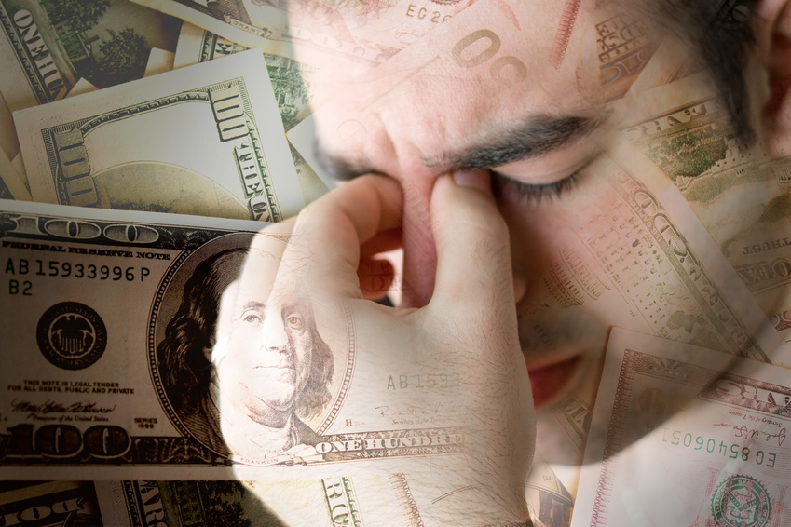

LOCAL CONTROL --- “OR NOT”

Slide 36
Questions

Slide 37

"This country has come to feel the same when Congress (The State Legislature) is in session as when a baby gets hold of a hammer."
Will Rogers

Slide 38
“The short memories of American voters is what keeps our politicians in office."
Will Rogers

Slide 39

"If we got one-tenth of what was promised to us in these acceptance speeches there wouldn't be any inducement to go to heaven."
Will Rogers

Slide 40
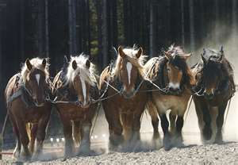
Working Together We Will Get Through This !!!

