Slide 1
Utah School Board Association
January 2018
USING ACT SCORE RESULTS TO IMPROVE ACHIEVEMENT & CAREER SUCCESS FOR ALL UTAH STUDENTS!

Slide 2
PRESENTERS
Stephen Allen, Ph.D.
President, Iron County School Board
Associate Provost for International Affairs, Southern Utah University
allens@suu.edu
Stephanie Lewis (on behalf of Sue Wheeler)
Senior State Lead – Client Relations, ACT, Inc.
Sue Wheeler: 847-736-1992/ sue.wheeler@act.org

Slide 3
Today’s Purpose
What do students’ test scores really mean? And, how do we know if students are meeting educational standards?
Do students’ interests line up with their academic and social/emotional skills?
How do we know if students are ready for college and career?
How do postsecondary institutions use ACT score results for recruitment, course placement and major/interest and career goals?

Slide 4
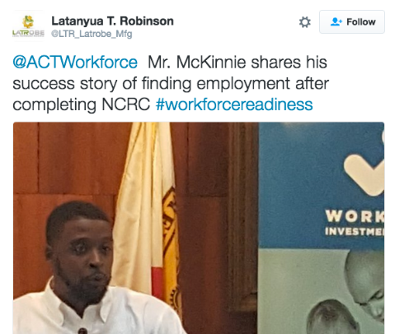
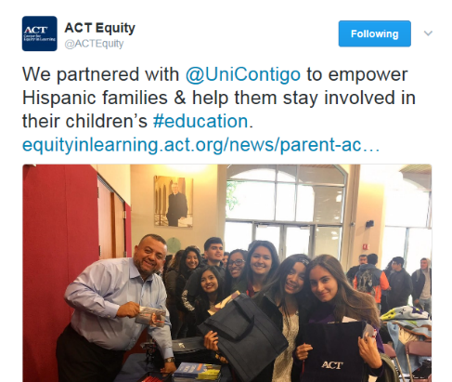
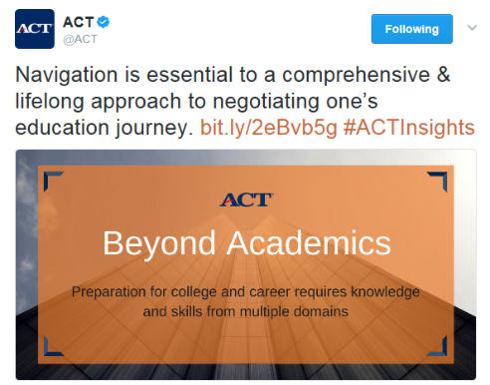
Today’s ACT
Mission-Driven We create products that genuinely help our customers succeed. | Research-Based We use data and research to drive policy, product and business decisions. | Nonprofit We re-invest in research, programs and services to support our mission.
Notes:
5 Minutes
ACT is a mission-driven, nonprofit organization dedicated to helping people achieve education and workplace success.
Mission-Driven
We serve students, parents, teachers, counselors, job seekers, policymakers and more, to boost lifelong learning and potential for success in schools and workplaces around the world. We’re passionate about making a difference in all we do. Each year, we reach millions in all 50 states and in more than 130 countries.
Not measuring, but helping
Not U.S. 11th graders, but people
Not aptitude, but achievement
Both education and workplace
Success on their terms, not ours
Research-based
Research lies at the heart of everything we do.
Readiness Matters: We are the only organization with decades of data showing individual performance relative to empirically derived standards of education and workplace achievements. ACT’s College and Career Readiness Standards are the backbone of ACT assessments, which describe the essential skills and knowledge students need to become ready for college and career.
Early-monitoring Matters: We have proven that early monitoring of readiness is associated with increased college success. Students who are better prepared academically for college have a greater chance of persisting in college and completing a degree. ACT research supports that early monitoring is also associated with college enrollment and college achievement.
Multiple Dimensions Matter: We know that success in school and the workplace is multidimensional. The ACT Holistic Framework provides a more integrated picture of education and work readiness from kindergarten to career with its inclusion of cross-cutting capabilities, behavioral skills, and education and career navigation, in addition to more traditionally measured core academic skills. We know that all of these skills can be measured, developed and improved upon with early intervention
Nonprofit
We do everything we can to level the playing field for everyone, regardless of needs, backgrounds, or resources.
Through purposeful investments, employee engagement, and thoughtful advocacy, the Center for Equity in Learning supports innovative partnerships, initiatives, campaigns, and programs that help people succeed in education and the workplace.

Slide 9
ACT Benchmarks and Standards—Data Driven
ACT National Curriculum Survey® drives the test content
ACT College Readiness Benchmarks—scores associated with postsecondary success in credit-bearing courses
ACT College and Career Readiness Standards—empirically based on an analysis of the skills and knowledge students need to respond successfully to an assessment question
Notes:
It is essential to understand that the tests are based on the ACT National Curriculum Survey, not the College and Career Readiness Standards, a common misunderstanding. The ACT National Curriculum Survey drives the test content.

Slide 12
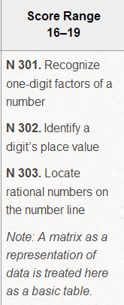
ACT College and Career Readiness Standards

Slide 16
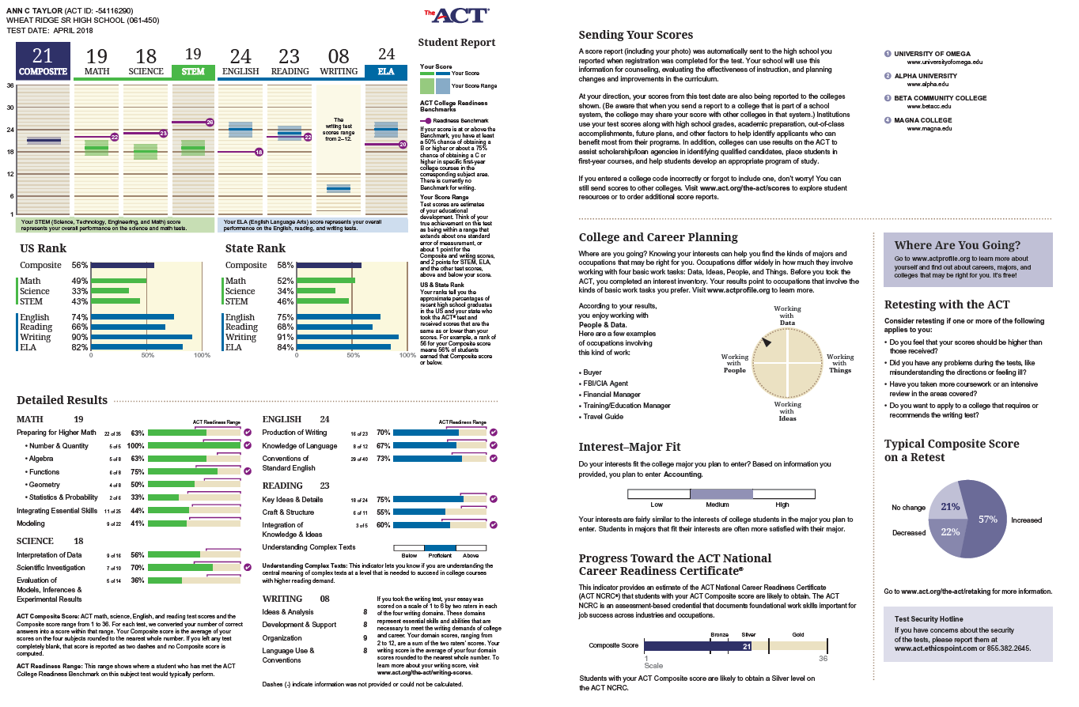

Slide 17
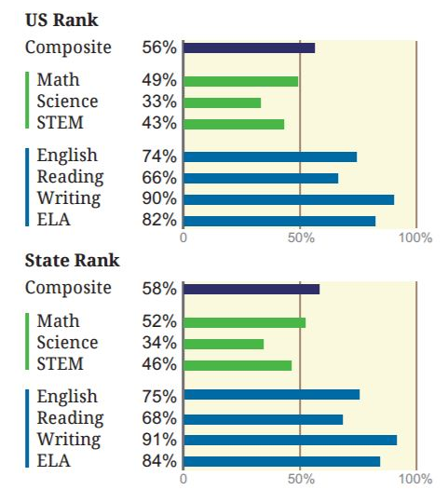
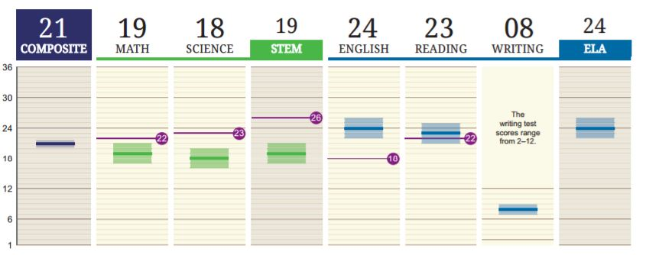
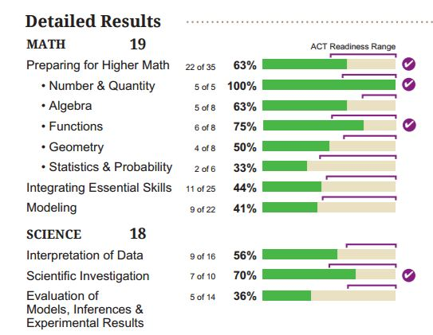
The ACT Test High School Report Insights
Scores
Composite scores and subject test scores tell you and your students which subjects need more focus before graduation
Readiness Range
This indicates where students who met this benchmark would perform on the ACT test, giving students and educators a target to meet for college readiness
Ranking Results
Students can use these numbers to “size up” competition they’ll face in getting into college

Slide 18
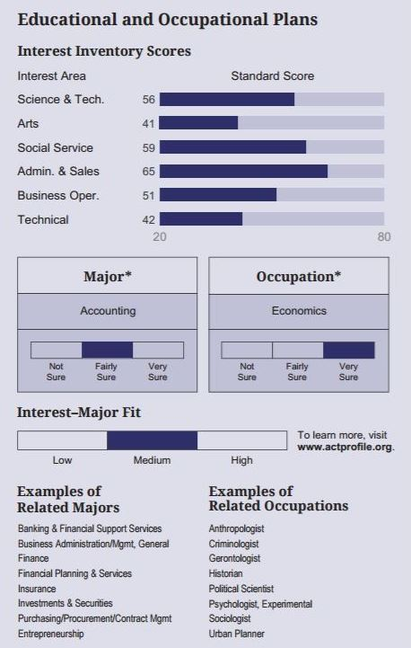
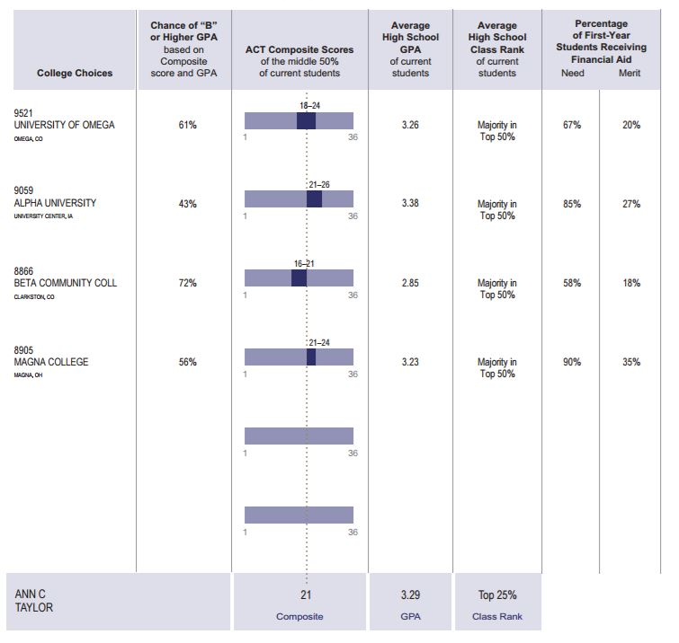
The ACT Test High School Report Insights
College Fit
Talk to your students about how each college sees their scores, how it meets their expectations, and what their scores say about how they’ll perform at the college
Educational and Occupational Plans
This helps your students compare their interests to majors and career areas

Slide 19
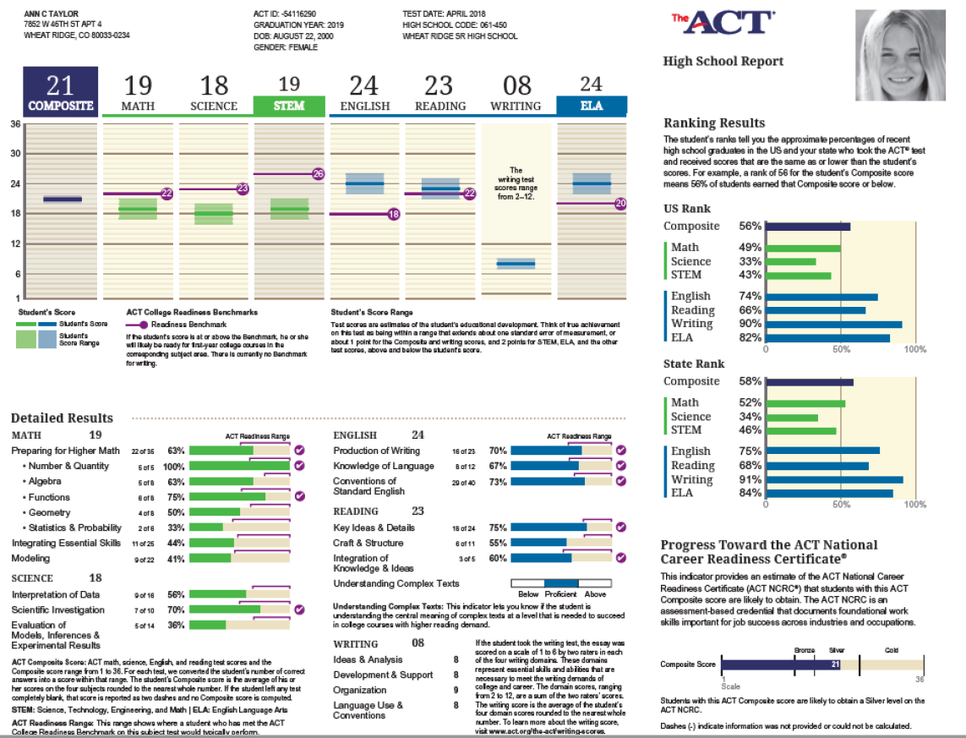
High School Report

Slide 20
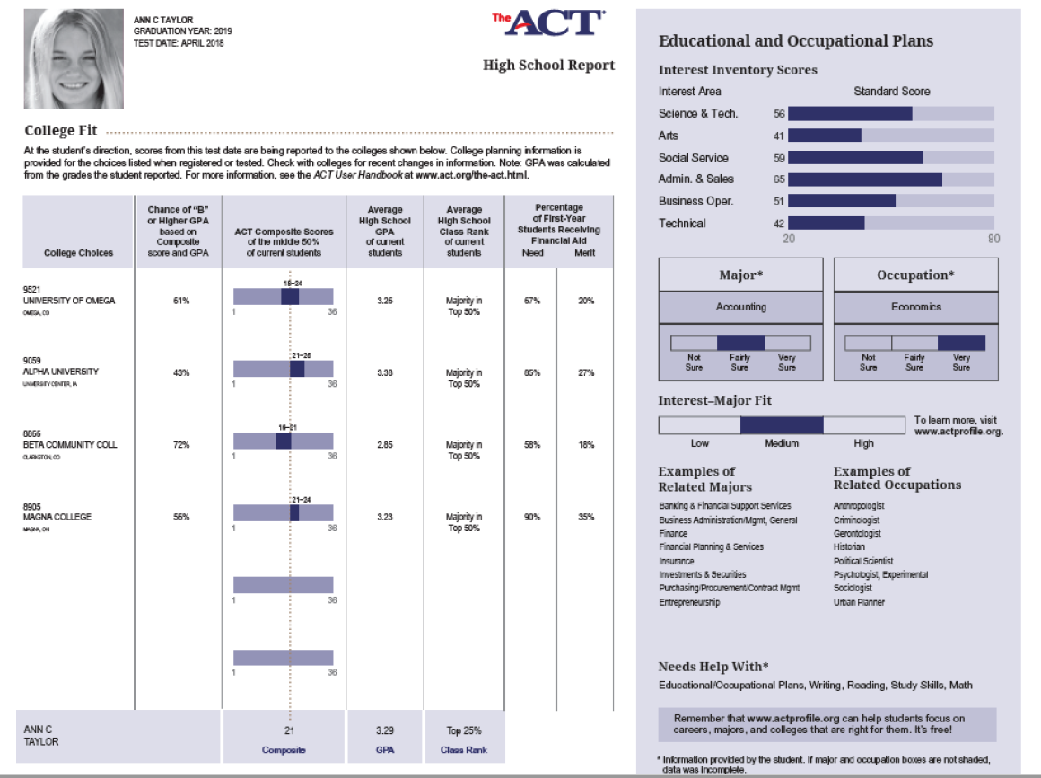
High School Report

Slide 21
College Report

Slide 22
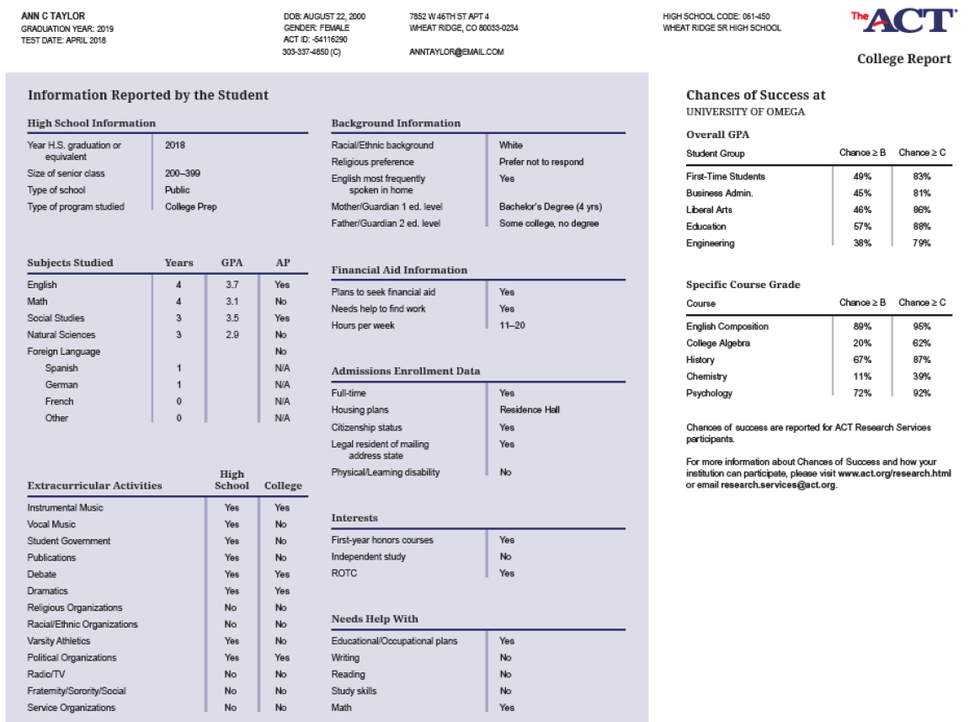
College Report

Slide 26
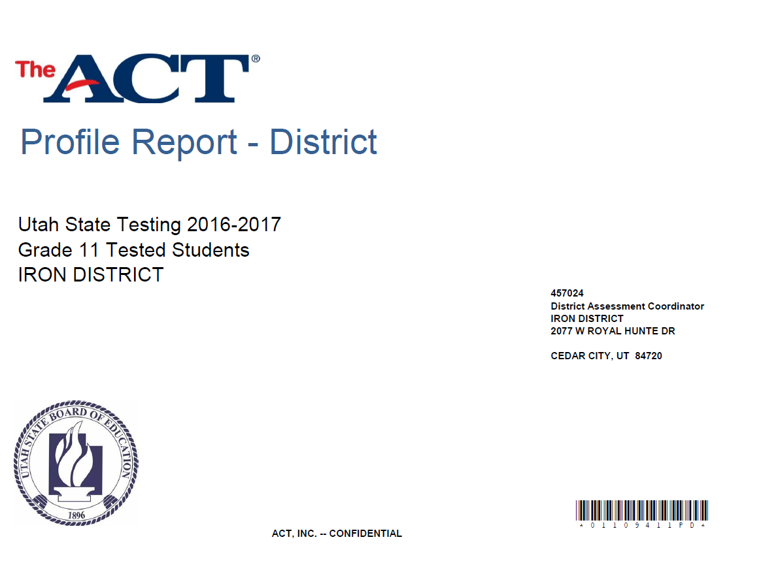

Slide 31
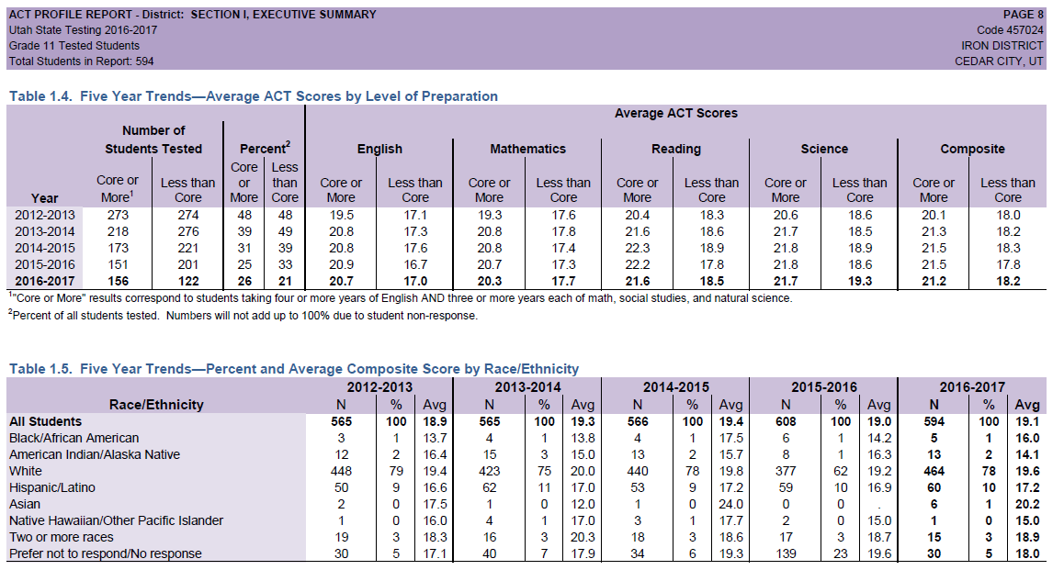

Slide 32
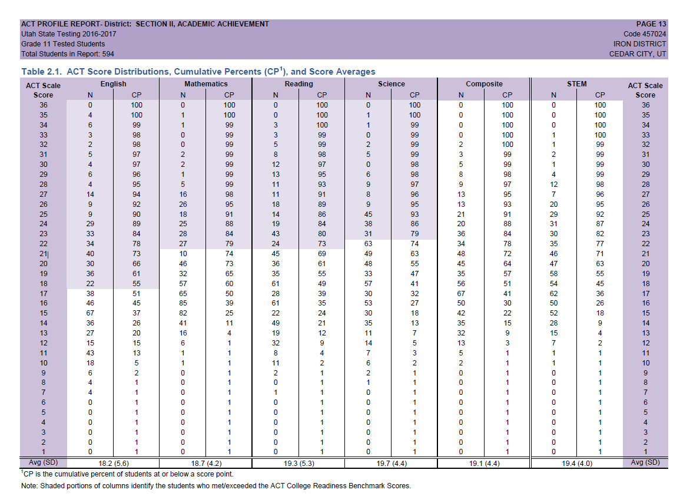

Slide 35
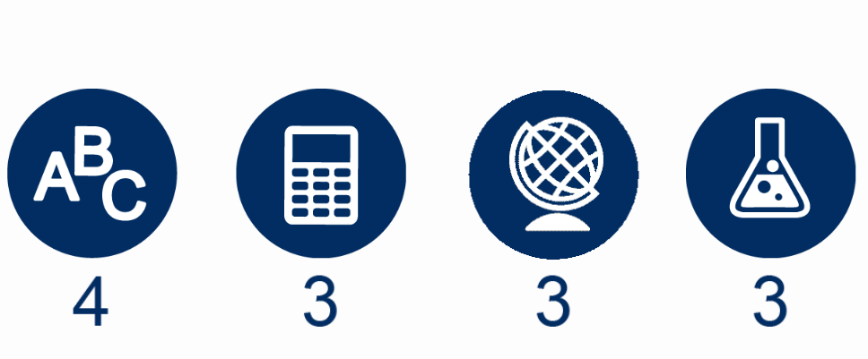

Slide 36
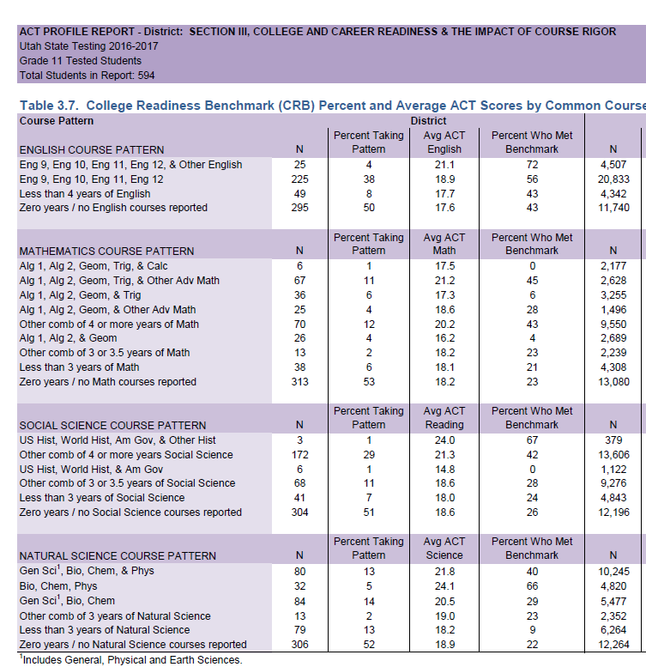

Slide 38
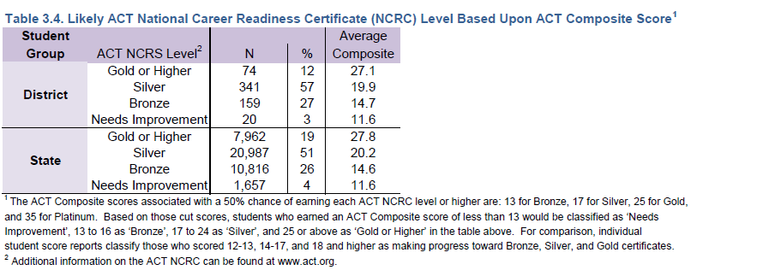

Slide 40
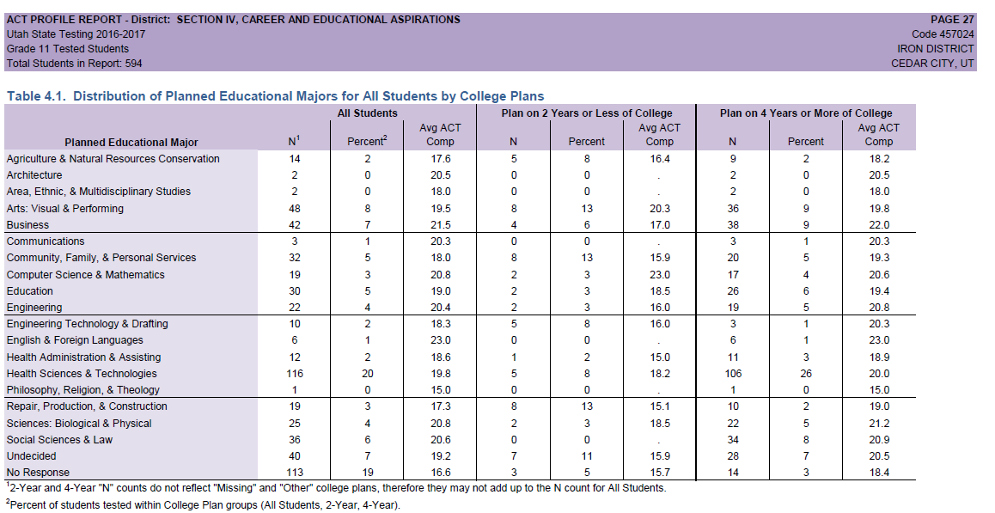

Slide 41
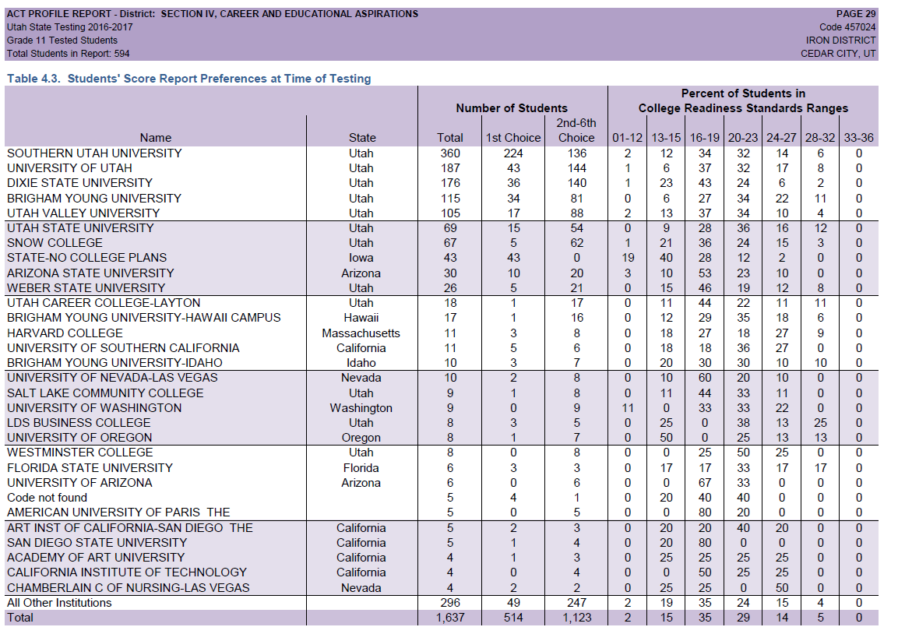
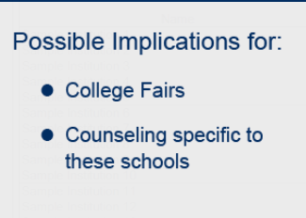

Slide 42
Preparing for The ACT (includes practice test)
ACT Kaplan Online Prep LIVE
The Official ACT Prep Guide
Question of the Day – changes daily
Free practice Questions online
OpenEd
Tips for Taking the ACT
Key:
ACT Sample Tests
ACT Online Prep
ACT Alternate Format Practice Tests
Free Resource
Paid Resource
Notes:
5 Minutes

