Slide 1
Legislative Hot Topics USBA Conference, January 10, 2020
Mary Nielsen, USBA Past President, Co-Chair, Joint Legislative Committee
Terry Shoemaker, USSA Executive Director

Slide 2
Agenda
Review December 12, 2019 Tax Reform Special Session (SB 2001, Sub. 4)
Discuss other pending legislation that will impact school districts
Review Actions of Executive Appropriations on Dec. 12, 2019 for FY 21 education budget estimates

Slide 3
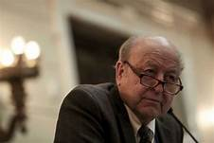
Task Force Tax Restructuring Policy Proposal
( SB 2001, 4th Substitute)
Budgetary Impact
• Results in an overall net tax reduction of approximately $155 million.
o A single filer would see an estimated average total tax reduction of more than:
▪ $20 per year if their income was $25,000
▪ $0 per year if their income was $60,000
▪ $45 per year if their income was $85,000
o A family of two would see an estimated average total tax reduction of more than:
▪ $50 per year if their income was $25,000
▪ $300 per year if their income was $60,000
▪ $325 per year if their income was $85,000
o A family of four would see an estimated average total tax reduction of more than:
▪ $270 per year if their income was $25,000
▪ $510 per year if their income was $60,000
▪ $125 per year if their income was $85,000
o A family of seven would see an estimated average total tax reduction of more than:
▪ $440 per year if their income was $25,000
▪ $1,040 per year if their income was $60,000
▪ $725 per year if their income was $85,000
Senator Lyle Hillyard
Co-chair Tax Task Force

Slide 4
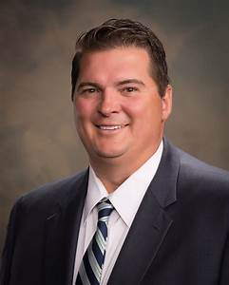
Policy Summary
This proposal includes the following policy modifications:
Tax Reductions
Income Tax
• Reduces individual and corporate income tax rates (Lines 1270, 1278, 1516)
• Expands the “Utah Dependent Exemption” provision of the taxpayer tax credit (Line1755)
• Creates an income tax credit for certain Social Security retirement income (Line 2251)
• Creates a “Grocery Tax Credit” for low-to-middle-income residents (Line 2345) (Rebate: Line 2399)
• Creates an Earned Income Tax Credit (Line 2429)
Sales Tax
• Exempts menstrual products and consumables used in the repair, cleaning, and maintenance of tangible personal property from sales tax (Lines 3241, 4801, 5536)
Rep. Francis Gibson
Co-Chair Tax Task Force

Slide 5
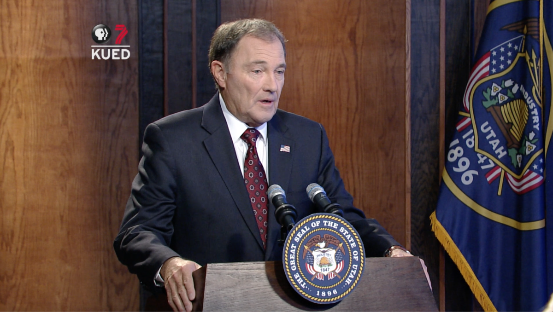
Tax Expansions
Sales Tax
• Restores the full sales tax rate on unprepared food (Line 4330)
• Expands the sales tax base by repealing certain sales tax exemptions (Line 4703)
• Expands the sales tax base by repealing the sales tax exemption for motor and some special fuels (Line 4707)
• Creating new excise tax on diesel rather than repealing sales tax exemption (Line 5695)
• Transitions to direct user fees for transportation costs (Line 6064)
• Expands the sales tax base by charging sales tax on certain services (Line 4280)
Other
• Increases the state Motor Vehicle Rental Tax (Line 5556)

Slide 6
Budget Shifts
• Restores some funding of Higher Education to the sales tax-backed General Fund (Line 6580)
• Funds school lunch program and underage drinking prevention program from Education Fund and deposits the portion of the liquor mark-up that currently funds the programs in the General Fund (Line 6568)
• Reduces sales tax earmarks for transportation (Line 4614)

Slide 7
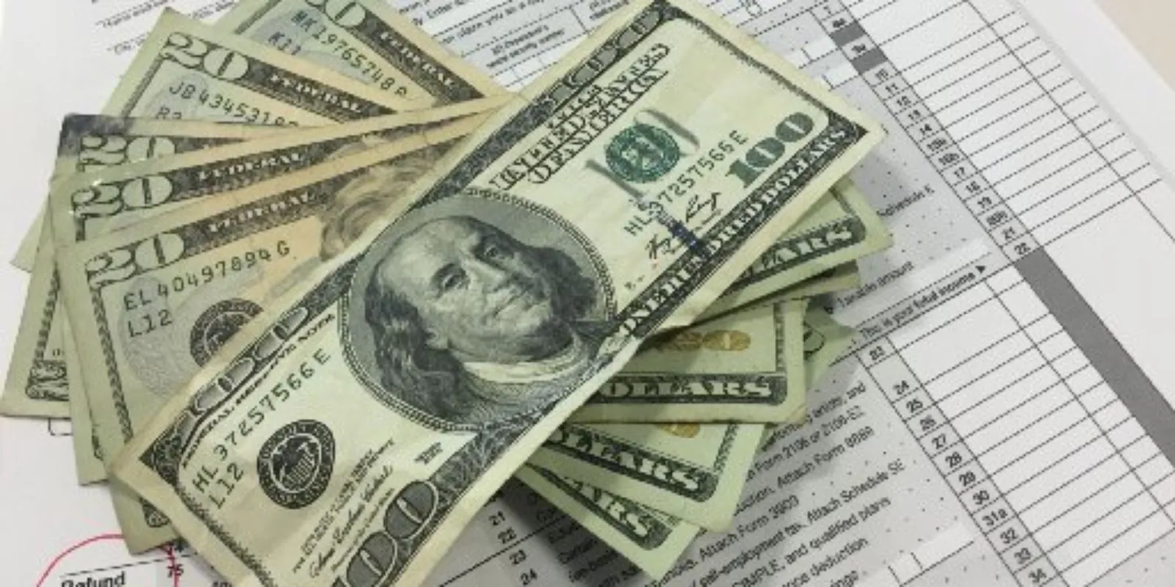
Policy Descriptions
Reduce Individual and Corporate Income Tax Rates by reducing the state income tax rate from 4.95% to 4.66%
AND
Expand the Utah Dependent Exemption
• Increases the exemption amount per dependent from $565 to $2,500
• Joint filers with no dependents will be able to claim one exemption
•Credit remains 6% of exemption amount and adjust for inflation
$14,879 for single filers
$22,318 for head of household filers
$29,758 for joint filers
One-time rebate for 2019 filers, equal to approximately half of the per dependent credit amount described above, to be paid in early 2020

Slide 8
Creates an Income Tax Credit for Social Security Income
• Non-refundable tax credit equal to total Social Security income included in Adjusted Gross Income (AGI) x State Income Tax Rate
• Amount of credit reduced by $0.025 per dollar that modified AGI (including Social Security and all other income) exceeds:
o $24,000 for married filers filing separately
o $30,000 for single filers
o $48,000 for head of household or joint filers

Slide 9
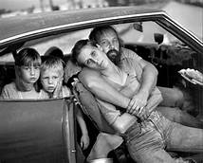
Create a State
Earned Income Tax Credit
• Refundable income tax credit to individuals identified by the Department of Workforce Services as experiencing intergenerational poverty and who claim the federal earned income tax credit
• Credit amount equals 10% of the federal credit amount an individual is entitled to claim
• DWS will conduct outreach to inform eligible individuals about credit

Slide 10
Grocery Tax Credit
Create a “Grocery Tax Credit” for Low-to-Middle-Income Residents
• $125 refundable income tax credit for the first four household members
o $50 refundable income tax credit for each additional household member
• For example, a family of four with a household income of up to $45,062 per year would
qualify for the full grocery credit amount (4x$125 = $500). That amount would be reduced
for each dollar the family makes over $45,062, with the credit phasing out entirely at
$73,633.
• A separate form will be created for claimants who do not file income taxes
$500,000 is appropriated to DWS to identify and assist eligible recipients who would not otherwise file a return

Slide 11
Sales Tax Changes
The current 4.85% sales tax on menstrual products eliminated
Unprepared food and ingredients state sales tax increases to 4.85% from the currently reduced rate of 1.75%
Multiple sales tax exemptions eliminated
Removes existing sales tax exemption on motor and some special fuels (does not include diesel or aviation fuel) to make the sales tax a broader consumption tax
Tax would be imposed at the distributor level on the average daily rack price of gasoline (calculated annually) at the existing state sales tax rate (4.85%)
General sales tax earmarks for transportation would be reduced due to new transportation revenue from motor and special fuel sales tax
$5,000,000 of new revenue from the sales tax on motor fuel will be appropriated for Class B Roads in counties with a population of less than 14,000. Money to be distributed in equal amounts

Slide 12
Additional sales tax changes
Creates a new excise tax on diesel of $0.06 per gallon starting in 2020 (April 1st) and $0.10 per gallon starting in 2022
Increase the state motor vehicle rental tax from 2.5% to 4.0%
Installation of tangible personal property when part of a taxable sale
The following new services to included in the sales tax base
Pet boarding, pet grooming, and pet daycare services
Personal transportation service
Motor vehicle towing
Parking lots and garages
Dating referral services
Identity theft protection
Streaming media
Shipping and handling when part of a taxable sale
Electronic security monitoring of real property

Slide 13
Other Changes to the General Fund
Deposits the current funding source for school lunch and underage drinking prevention, a portion of liquor markup profits, into the General Fund
Reduces Education Fund appropriations to Higher Education and replace those Education Fund appropriations with a like amount of General Fund appropriations

Slide 14
FY 2021 Budget Effects from Income Tax Cut
Reduced income tax rate (4.66%) ($348,000,000)
Expanded Utah Dependent Personal Exemption ($132,000,000)
Social Security credit ($18,000,000)
Earned Income Tax Credit ($6,000,000)
Grocery credit ($135,000,000)
Total: ($639,000,000)

Slide 15
Sales and other Tax new Revenues
Exempt additional products from sales tax ($5,000,000)
Restore full sales tax on food $250,000,000
Repeal certain exemptions $16,000,000
Sales tax on motor fuel/excise tax on diesel $170,000,000
Tax certain services $43,000,000
Increase motor vehicle rental tax $4,500,000
Total: $478,500,000

Slide 16
Budget Shifts
Fund school lunch and underage drinking prevention from Education Fund ($39M)
Fund some additional higher education from General Fund ($391M)
Direct a portion of new sales tax on fuel to transportation projects ($34M)
Replace gas tax earmark for transit with sales tax earmark for transit (future $6M)
Net ongoing fiscal impact ($160,500,000)
Net one-time fiscal impact ($72,000,000)

Slide 17
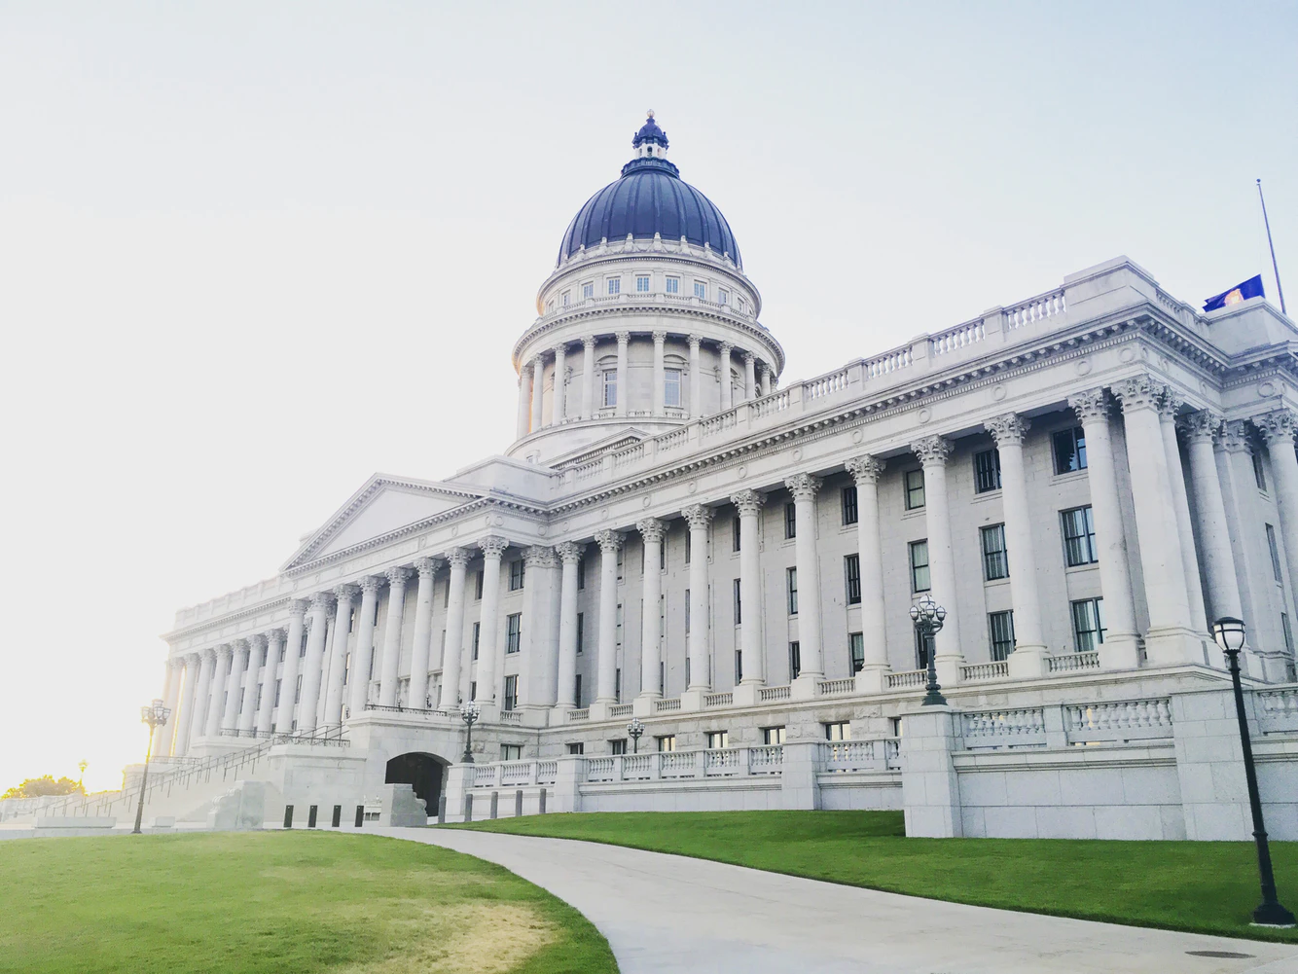
What happened with proposed changes to income tax earmark
No Proposed Changes in Dec. 12, 2019 Special Session
Utah Legislature to discuss income tax constitutional amendment earmark change in the 2020 General Session (HJR 5, Ray Ward)
No response from legislative leaders on USBA proposed constitutional changes

Slide 18
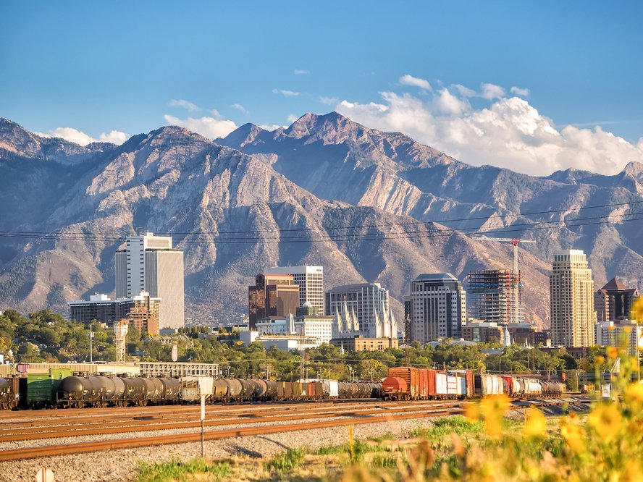
What happened to the property tax proposal to supplement education funding
No discussion or action on property tax proposal to supplement public education revenues occurred in the December 12, 2019 2nd Special Session
HB 77 Education Funding Amendments (Rep. Norm Thurston)

Slide 19
Executive Appropriations Budget limits
Met on Dec. 13, 2019 to review latest FY 21 revenue *estimates
Set aside $14.5 million in the Education Fund Reserve Account
**Enrollment growth $50.6M (ongoing) + $4.7 M (one-time)
***Education Fund $214 M (ongoing)
December 2019 Tax Reform and Tax Restructuring Special Session in calculations
** Funded for FY21
*** Revenue updated in February and can be used for both public and higher ed with possibility of more funding to higher ed coming from the General Fund

Slide 20
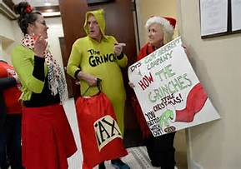
What about the referendum to repeal the tax reform legislation
Backers of the referendum need to collect approximately 116,000 validated signatures by Jan. 21 to qualify for the November ballot
As of Jan. 2, 2020 only 549 signatures had been validated by the Lt. Governor’s office (Fox13, Jan. 2, 2020)
UEA is not supporting the signature gathering process, but individual educators are participating
Polls indicate that Utah Public not supportive of the recent tax changes

Slide 21
Other hot topics
SCHOOL MEALS PROGRAM AMENDMENTS
SCHOOL MEALS PROGRAM AMENDMENTS
HB 67 Local Education Agency Financial Information Systems ( Rep. Melissa Ballard)
HB 80 School Fees Amendments (Rep. Adam Robertson)
HB 68 Apprenticeship and Work Based Learning Amendments (Rep. Francis Gibson)
HB 88 School and Child Care Center Water Testing Requirements (Rep. Steve Handy)
HB 14 School Absenteeism and Truancy Amendments (Rep. Lowry Snow)
HB 16 School Meals Program Amendments (Rep. Dan Johnson)
HB 99 Enhanced Kindergarten Amendments (Rep. Lowry Snow)
HB 103 Utah Promise Scholarship Program Amendments (Rep. Derrin Owens)

Slide 22
Questions or Comments?

