Slide 1

Utah School Boards Association
Spring Regional Meetings
March 2020

Slide 2
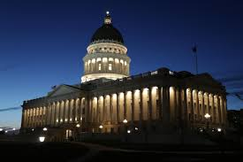
2020 Spring Regional Meetings
Agenda
Welcome…
Coronavirus Update
Legislative Report
Region Business/Legislative Priorities 2021
Other Items

Slide 3
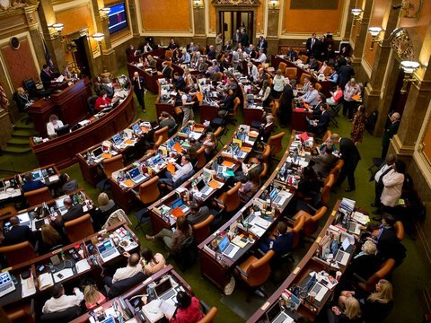
USBA Spring 2020 Regional Meetings
65th Legislature Highlights
They passed 551 bills. The JLC took positions on 42 bills, supported 38 bills, and opposed several. We also took no position on around a half-dozen bills.

Slide 4
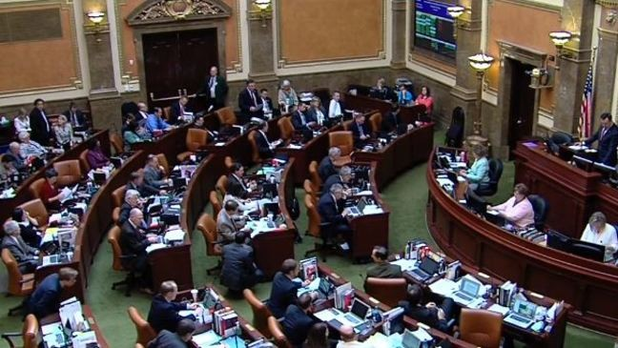
Legislative Report
Appropriations Changes
Important Bills
Answer questions

Slide 5
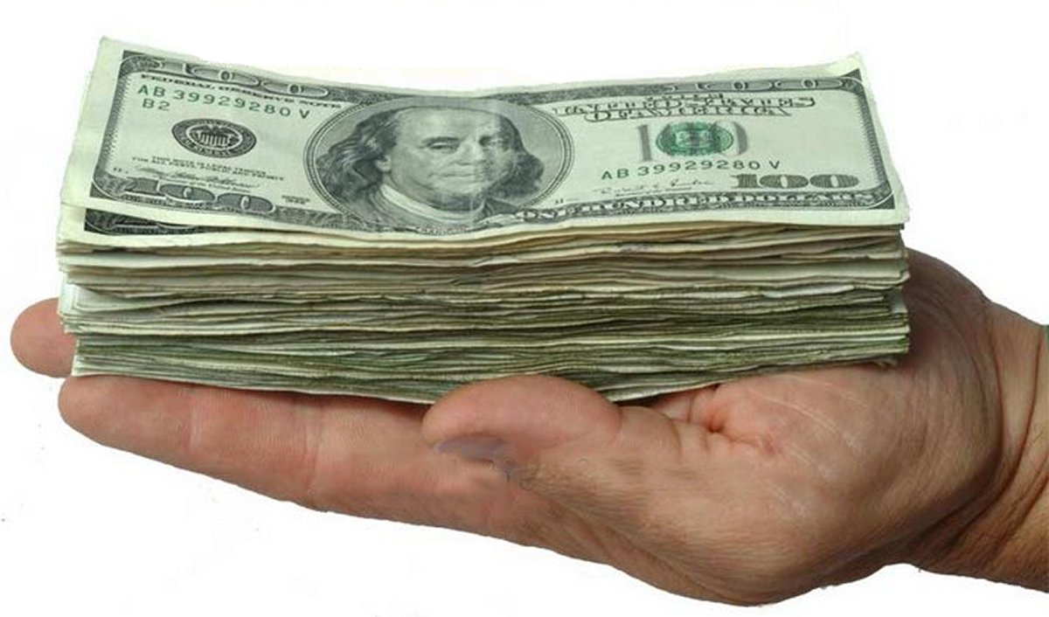
FY 21 New Appropriation Changes
$50.6 M to fund growth in BASE Budget, HB1
$204 M for 6% WPU increase ($3745, SB2)
$75 M for Public Education Stabilization Fund (HB3)
$30 M one-time (Safety & school priorities, HB3)
$5 M Transportation (To & From, HB 2)
$700 K NESS (HB2, SB2)
200 WP Units for Isolating Schools (SB2)
$20.6 M WPU Value Rate for TSSA (HB 77 limits to 4%, SB2)
$530 K Educator Salary Adjustments (HB 141, SB2)
$500 K Student Mental Health Screening (HB 3)
$7 M Computer Science Initiatives (SB2)
$3 M Kindergarten Supplement Enrichment (SB2)
$428 K Effective Teachers in High Poverty Schools (HB 107)
$88 M Land Trust Funds to School Community Councils
$4.3 M Electronic Cigarettes in Schools (HB 58)
$ 350M total increase

Slide 6
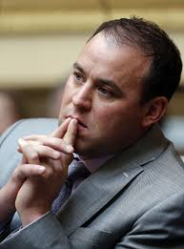
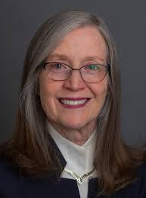
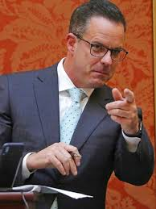
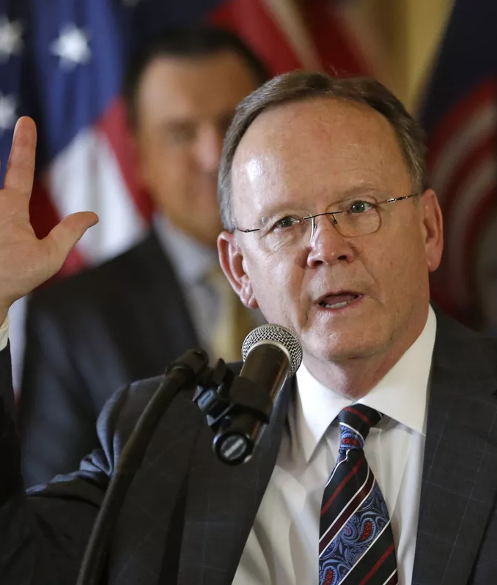
New Education Funding Model
HB 357, Public Education Funding Stabilization
SJR 9, Proposal to Amend Utah
Constitution
Linked together…must be approved by the voters in Nov. 2020 election
Requires education fund to place monies in the Uniform School fund that are restricted to K-12
Uniform School Fund has a constitutional protection
Provides for automatic funding for enrollment growth and inflation in the base budget…sets the floor
Creates a fund of ongoing money to support K-12 funding during economic downturn

Slide 7
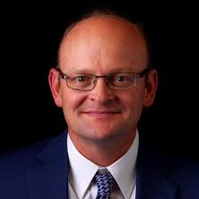
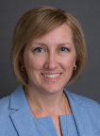

School Fees
HB 88, School Fees
  Data Collection
Rep. Adam Robertson
HB 391, School Textbook Fee Amendments
Rep. Karianne Lisonbee
Requires school district to measure the collection of school fees
By July 1, 2020 determine which fees are curricular, cocurricular, or extra-curricular
For the 2020-21 school year measure the number of students and the dollars paid for fees that are curricular, co-curricular, and extra-curricular; measure the number and value of fee waivers
Expands the definitions of school textbook, instructional equipment, school equipment, instructional supply, and how they relate to the charging of school fees

Slide 8
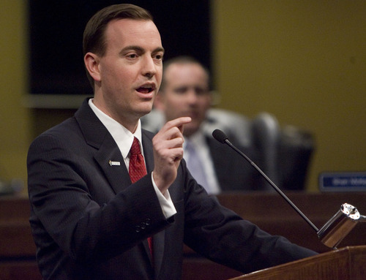
HB 107, Effective Teachers in High Poverty School Incentive Program
Rep. Mike Winder
Adds Teachers in Grades 1-3 to qualify for the Incentive Program
Increases the incentive to $7000
Grade 1-3 teachers qualify by having 85% of students receiving typical or better on state end-of-year benchmark assessment

Slide 9
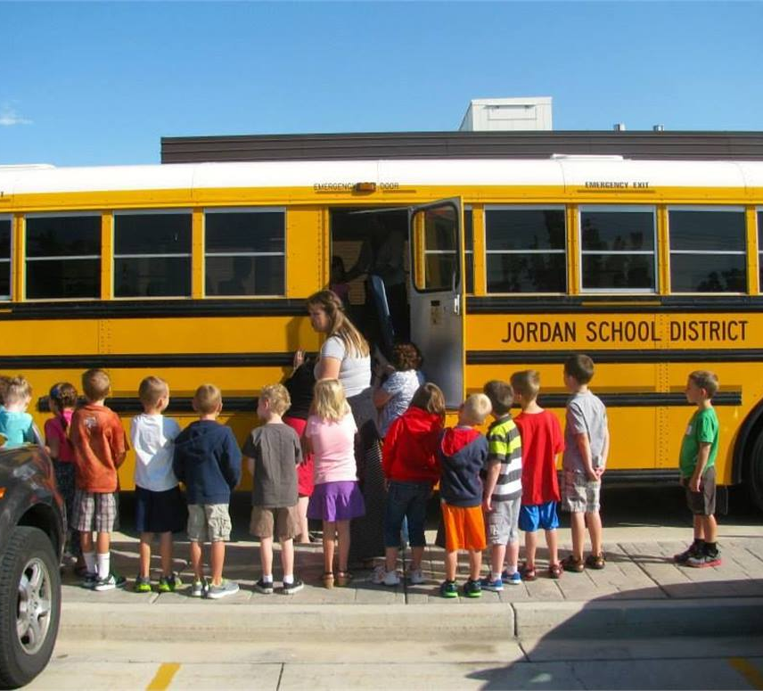
HB 143, Perry, L. School Bus Safety Inspection Amendments
Randomly perform inspections on 20% of bus fleet annually
Verify that defects have been corrected
Provide annual report

Slide 10
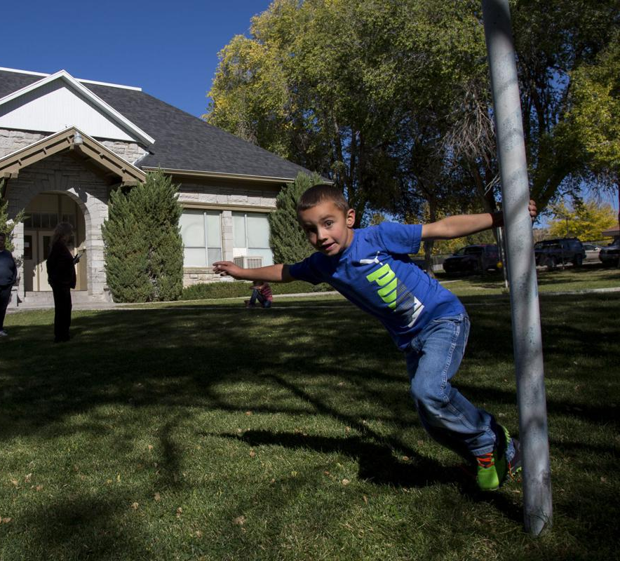
HB 434, Owens, D. Funding for Necessarily Existent Small Schools
Bill amends provisions to how NESS Schools are funded
The word “regression” is removed and replaced with distribution formula.
Secondary add-ons remain the same whether you have more than 15 or fewer secondary students
Adds “isolated small schools” to the statute
$100,000 appropriated to help school districts in counties of the fourth, fifth class to reimburse activity costs

Slide 11
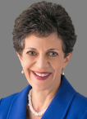
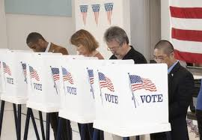
HB 70, Arent, P., Repeal of Single Mark Straight Party Ticket Voting
Removes the ability to cast a straight party ticket vote

Slide 12
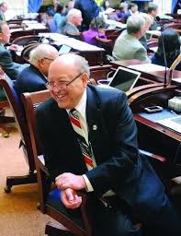
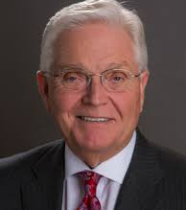
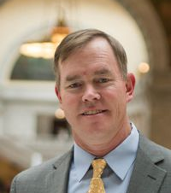
Grant Programs
HB 99, Snow, Enhanced Kindergarten ($10 M)
SB 2, Hillyard, Computer Science ($8M)
HB 114, Waldrip, Early Learning Training and Assessment ($ 5M)
SB 99. Millner, School Leadership Development ($5 M)

Slide 13
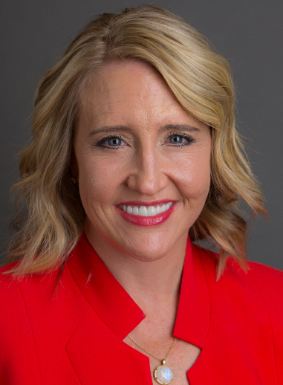
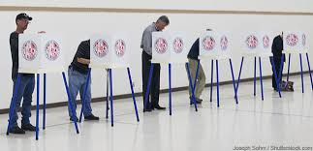
HJR 13, Ballard, M. Proposal to Amend Utah Constitution
State Board of Education
This bill would allow the public to decide whether to have the State Board of Education appointed by the Governor.
It would have needed a companion bill to determine the specifics…the bill never surfaced
Rep. Ballard asked the Education Committee to hold the bill. The bill never made it to a vote either in committee or on the floor of the House or Senate
Net impact is that for two successive election cycles (2020, 2022), all elections involving USBE members will be partisan.
Rep. Melissa Ballard

Slide 14

Bills We Opposed
HB 236, Ballard, M., Safe School Route Evaluations
HB 251, Ballard, M., School Construction Project Amendments
SB 91, McKay, D., Election Process Amendments
SB 163, Harper, W. Community Reinvestment Agencies
HB 69, Arent, P., Sick Leave Amendments
SB 107, Fillmore, L., Income Tax Rate Reductions

Slide 15

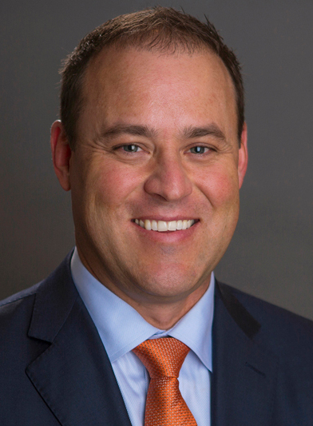
HB332, Shultz
Special Needs Scholarships Amendments
Creates the Special needs Scholarship Program
Establishes the criteria for scholarship recipients and receiving private schools
Establishes a scholarship granting organization overseen by USBE
Creates a nonrefundable corporate and individual income tax credit.
Only for IDEA qualified
$6 million cap FY21
Home school not eligible
Rep. Mike Shultz
House Majority Whip

Slide 16
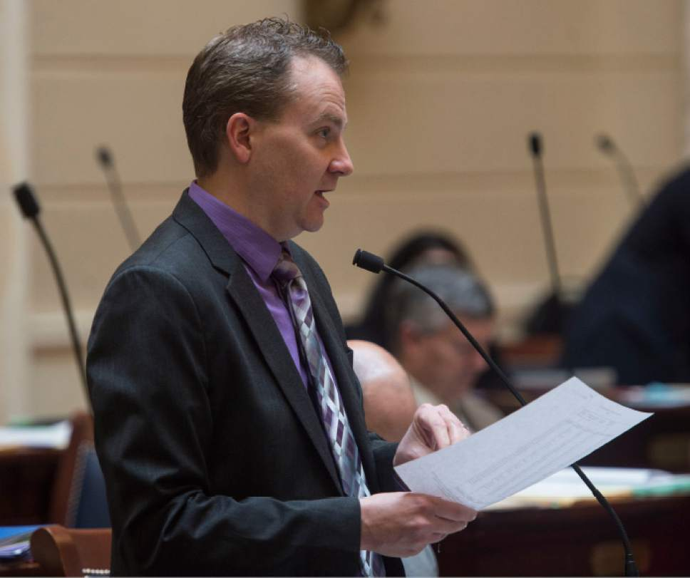
SB 104, Filmore
Local Education State Guarantee
JLC Took No Position on this bill
Appropriated $19,000,000
Increases the guarantee rate
Does not change the increments guaranteed

Slide 17
Let’s Check the Scorecard
Fully Fund enrollment growth (estimated $35 m) Funded $50.6 million
Fund current levels of service with increase (6% WPU) Funded 6% WPU
Fund to/from Transportation ($5 m) Funded $5 million
Necessarily Existent Small Schools ($500k) Funded $700K
School Safety *Funded $30M
Support No School Grading **SB 119
Support Constitution Income Tax Dedication SJR 9
Solutions to State’s Structural Tax Imbalance SJR 9
Impact fees for schools NO
Automatic inflation adjustment HB 357
          *Caution: One-Time only
          ** Fiscal Years 19, 20 only

Slide 18

Potential Dangers Ahead
Some economists are predicting a contraction in economic growth in the second quarter, with some extension into the third quarter, and possibly beyond
Legislature will meet in Special Session to amend FY 21 budgets if revenue forecasts portend serious economic slowdowns
School Boards should consider these things as budgets are planned for FY21

Slide 19

2021 Legislative Priorities
Input from you
Notes:
We would like to take a few minutes and gather information from you. What are priorities that you would have us pursue for the 2918 Legislative Session? (Write their priorities down on a separate piece of paper.)

