Slide 1
EveryDay Strong

Slide 2
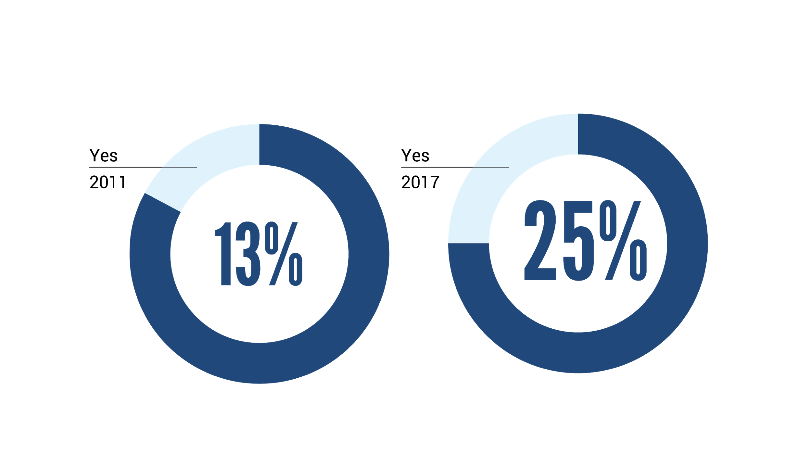
Utah Youth Are Struggling
Utah County youth are struggling
Youth: during the past 12 months, did you ever feel so sad or hopeless almost every day for two weeks or more in a row that you stopped doing some usual activities?
Utah SHARP Survey of 6th, 8th, 10th, and 12th graders
2011
2019
14.3%
28.2%
Notes:
EXPLAIN SHARP data briefly. Point out that many, many kids in our community are struggling.
Key points: the number has almost doubled since 2011. It’s time to take action. (FYI, it was 17% in 2013 and 22% in 2015.)
Purpose of this slide: for those who may not have heard about or understand the extent of the mental health struggle among youth.
Questions you may get asked:
Q: What is SHARP data?
A: A survey administered via the school districts to 6th, 8th, 10th, and 12th graders throughout the state. This is Utah County only data, but the trends are similar throughout the state. They ask about drugs, mental health, home, and neighborhood situations, etc.
Q: Isn’t this increase just due to “how we classify mental health?”
A: No. This isn’t “number of children diagnosed”—this asks only about feelings and behavior.
But a “yes” answer indicates a strong probability of clinical depression.

Slide 3
What could be causing this?
Notes:
Zoom action: chat in the box some things you’ve heard about what’s behind this trend
Purpose of this slide: to show that there are a LOT of theories about mental health.
Step 1: state that often when we show people the data, the first thing they want to know is WHY mental health issues are rising.
Step 2: offer a few possibilities (cell phones, altitude, school). You may invite the audience to add one or two more.
Step 3: state that some of these are probably correct, and some of them are probably overblown, BUT we want to take a step back for a moment from “causation theories.”
IMPORTANT: Do not spend too much time on this slide! It is primarily a transition from slide 3 to slide 5.

Slide 4
Environmental:
Focus on the conditions, clothing, weather, timing
Biological:
Focus on better sleep, nutrition, stretching, weight, genetics
Educational: Focus on education or the person’s knowledge about physiology, the course
The marathon runner: why does someone fail?
Psychological: Focus on ways to improve motivation or self-reflection
Social: Focus on peer motivation, training together, bigger cheering section
Spiritual: Focus on prayer, faith, spiritual preparation
Notes:
Purpose of this slide: to demonstrate how both physical health and mental health challenges are very complex!
Step 1: Set up the metaphor: Imagine you know someone who is trying to run a marathon and they are failing.
Step 2: Walk the audience through each item (biological, psychological, etc.).
Step 3: Ask: Which of these is the CAUSE of why someone fails?
Zoom action: run the poll
Ask for a few people to unmute and explain why they chose what they did
Answers may include: all of them; some of them; it depends on the person; they interact with each other; and it’s complex!

Slide 5
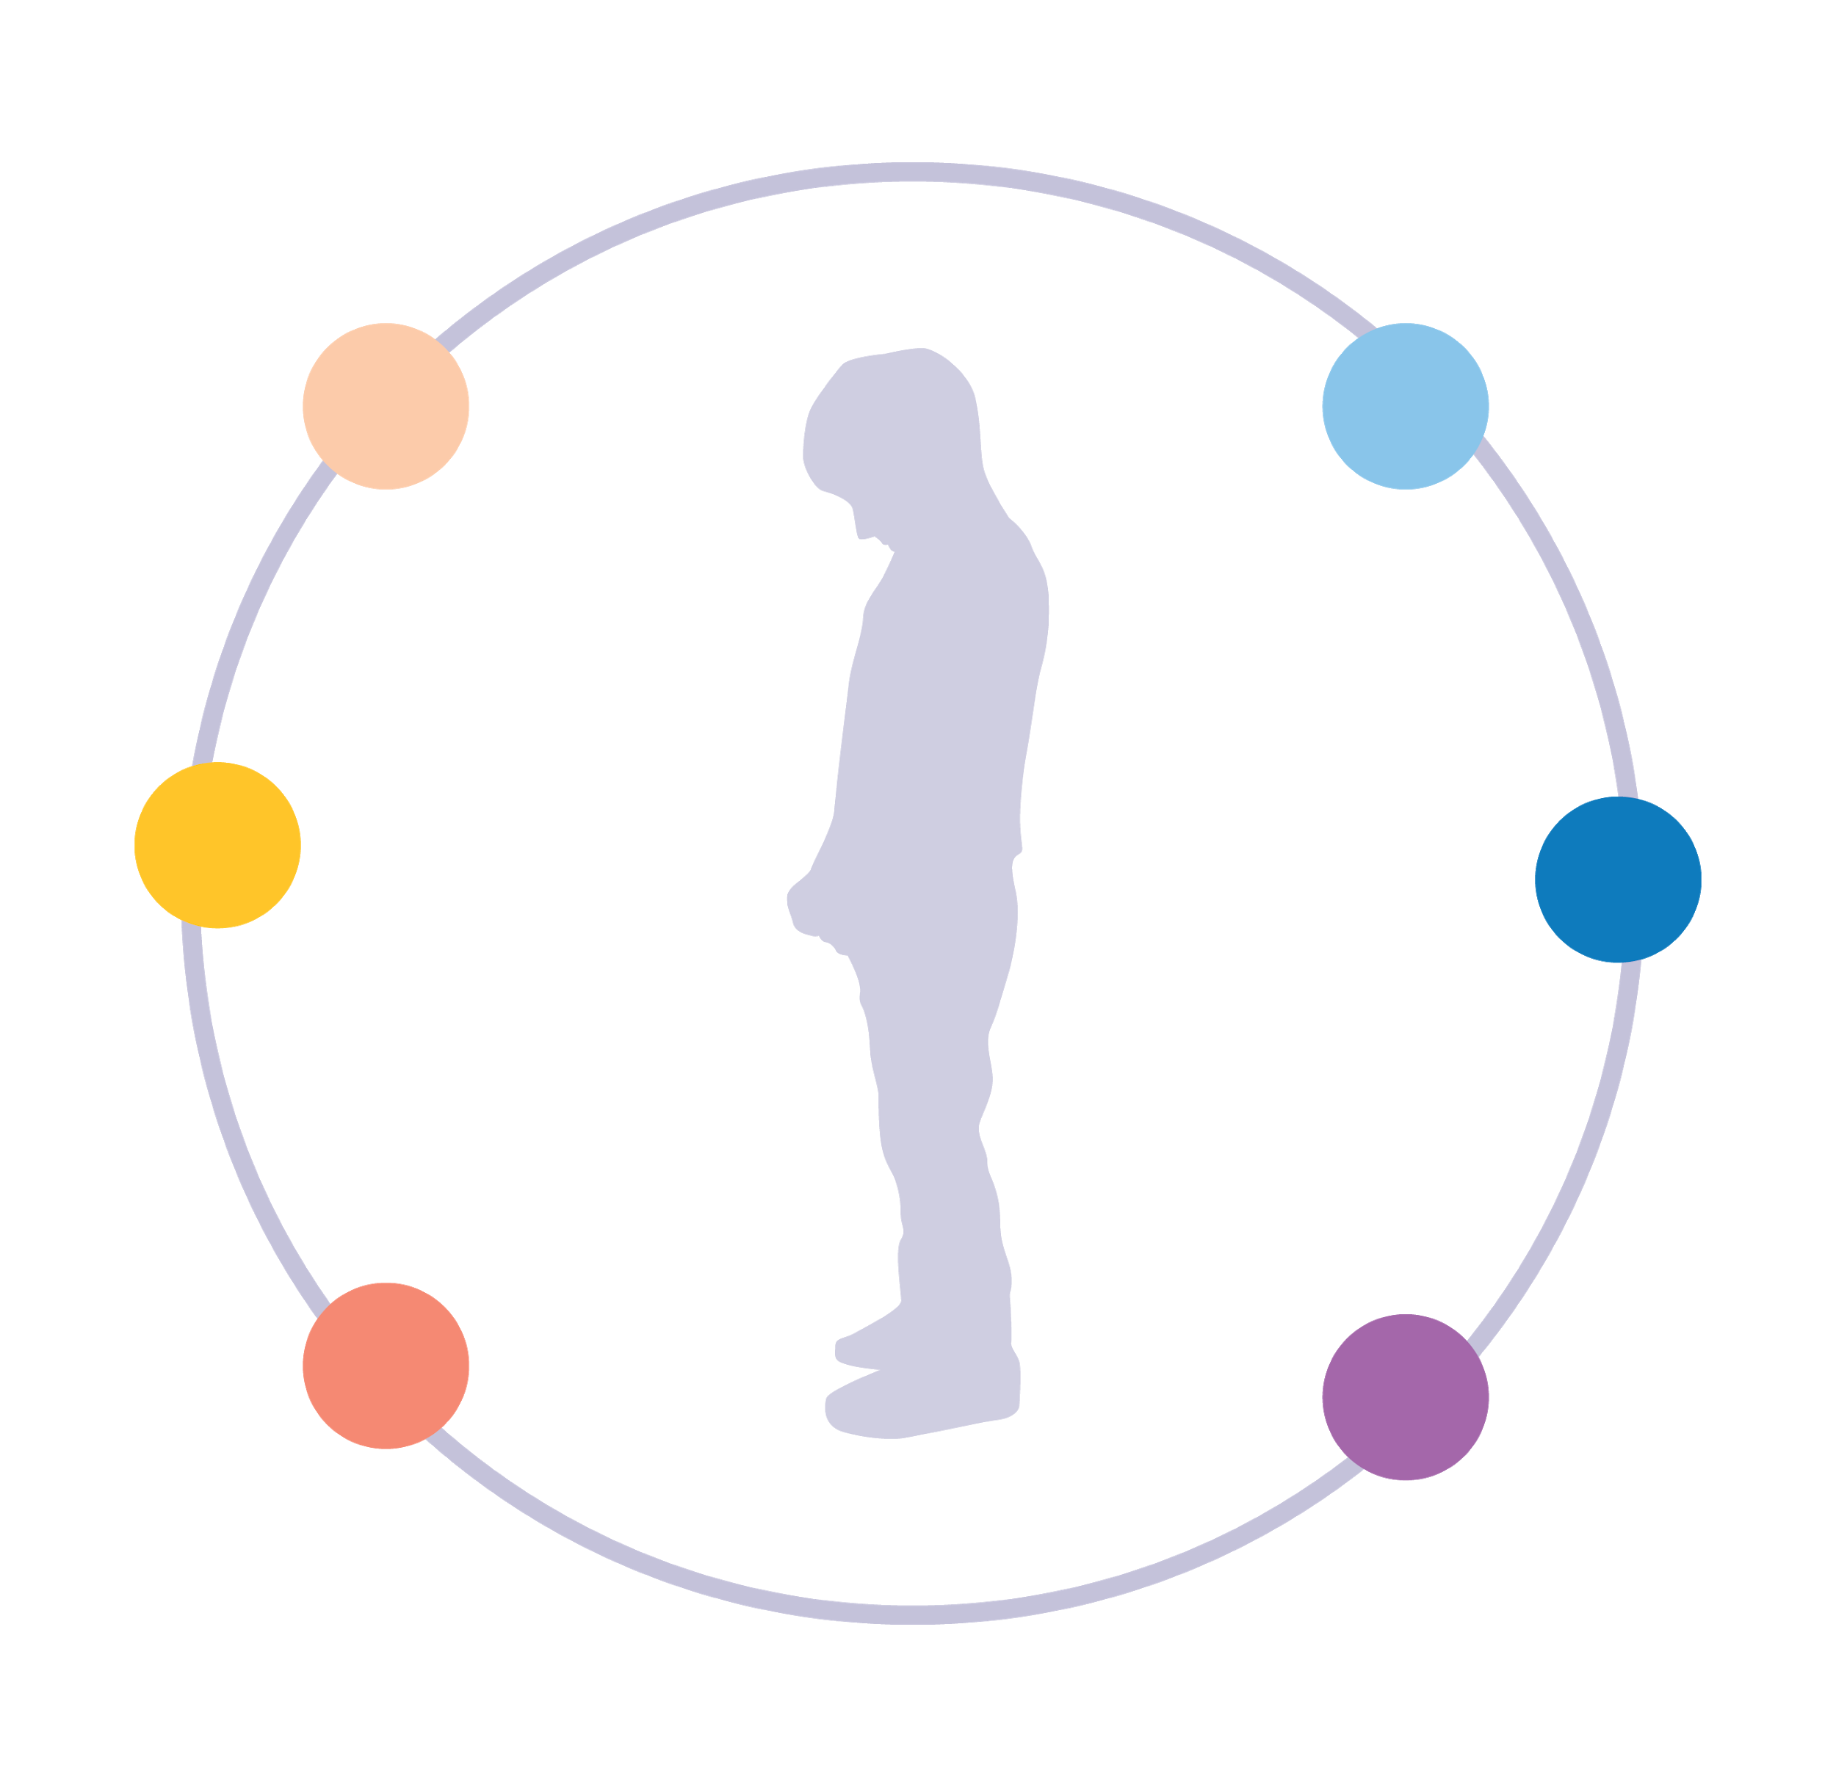
Biological:
Genetics, quality of sleep, chemical imbalances, neurology, diet, exercise
Environmental:
School, church, cell phones, altitude, culture
Educational: Coping skills, knowledge of how mental health works, “decrease the stigma”
What if it were an anxious or depressed child?
Psychological: Focus on ways to improve motivation, self-reflection, therapy
Social: Lack of support from friends or family, bullying
Spiritual: Focus on prayer, faith, spiritual preparation
Notes:
Step 1: Ask the audience—what if instead of a marathon runner, we talked about an anxious or depressed child? Which of these is the “right” answer to why someone struggles? (Let them just sit with that thought for a moment.)

Slide 6
How can you help someone if you don’t know what’s causing the problem?
Focus on what they need.
Notes:
STATE: the desire to figure out the cause behind someone’s mental health concerns comes from a good place. We want to be helpful. But hopefully you are convinced that it’s really, really hard to figure out the cause.
READ or SUMMARIZE the text on the slide.
Purpose of this slide: transition from slide 6 to slide 8.

Slide 7
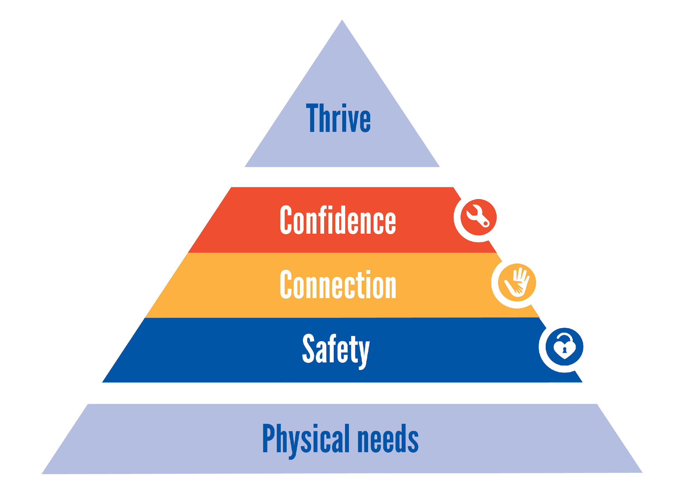
Notes:
How do we know what someone needs?
Step 1: ASK: How many of you are familiar or have heard of Maslow’s Hierarchy of Needs?
Maslow said: when people’s needs are met, then they thrive. And when they’re not met, then they don’t thrive.
Step 2: STATE: For example, most of us can agree that kids who don’t have enough to eat struggle to do well in school—that when your need for food isn’t met, it’s a barrier to success.
But did you know that human beings have other needs that create barriers to thriving beyond food and rest?
They are emotional needs. We call them safety, connection, and confidence. (click to slide for a video explanation)
THIS is the key of the whole presentation: when you meet people’s needs, then they thrive.

Slide 8
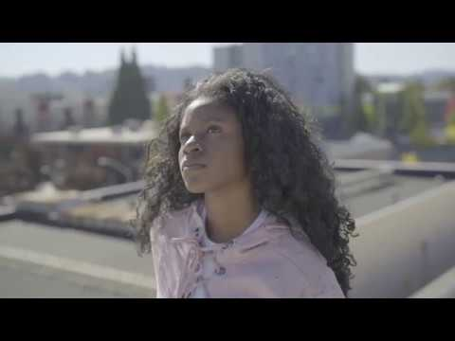
Notes:
Let’s watch this video that goes into greater depth.
Zoom protocol: to share the video, you’ll need to hover over the green Zoom bar that says “you are screen sharing.” Then go to “more” and hit “optimize share for full screen video clip.” This will share the sound and remove the other participant’s videos temporarily. (Just make sure to “uncheck” this when you’re done!)

Slide 9
Lens shift
Focus on what YOU can do, NOT on what THEY need to change
Trust that when you do, they will thrive!
Notes:
It’s not only about needs.

Slide 10
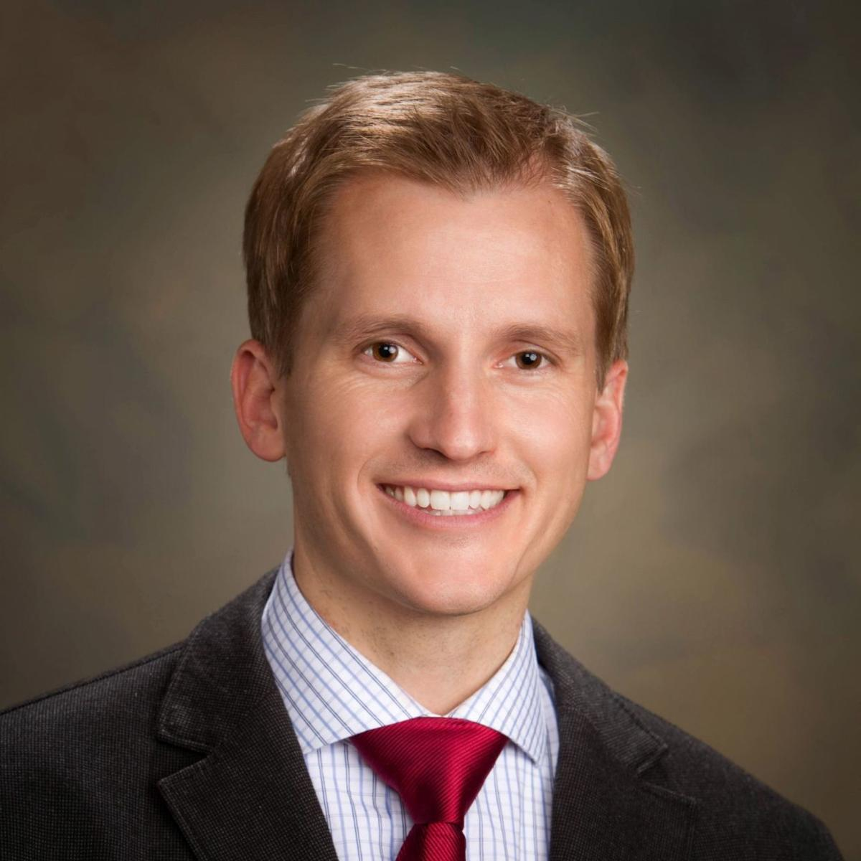
“Resiliency is not a skill.
When you look closely at those layers on Maslow's hierarchy, you can line those up almost literally with the resiliency research, that's coming out about the need for connections, about making them feel like there's this internal locus of control that they have power over their life about the need to help them feel safe.”
Dr. Matt Swenson
EveryDay Strong co-founder
Child Psychiatrist, formerly at Intermountain Healthcare

Slide 11
schools, businesses, and cities who want the kids in their community to be emotionally strong
Allies receive free tools (like posters and videos) to teach the caring adults in their community how they can be the #1 factor in building youth resilience
easy to implement and very customizable for your organization
EveryDay Strong Allies

Slide 12
Alpine, Provo, Nebo School Districts

Slide 13
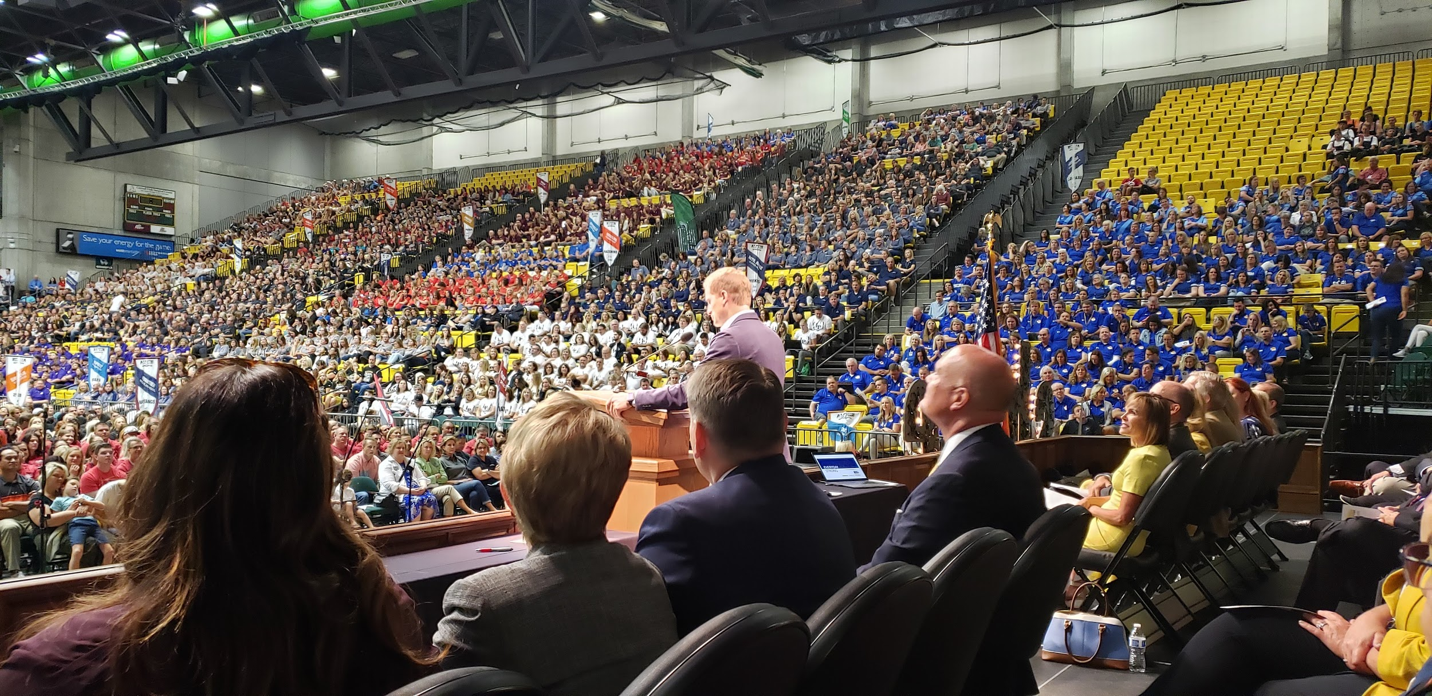

Slide 14
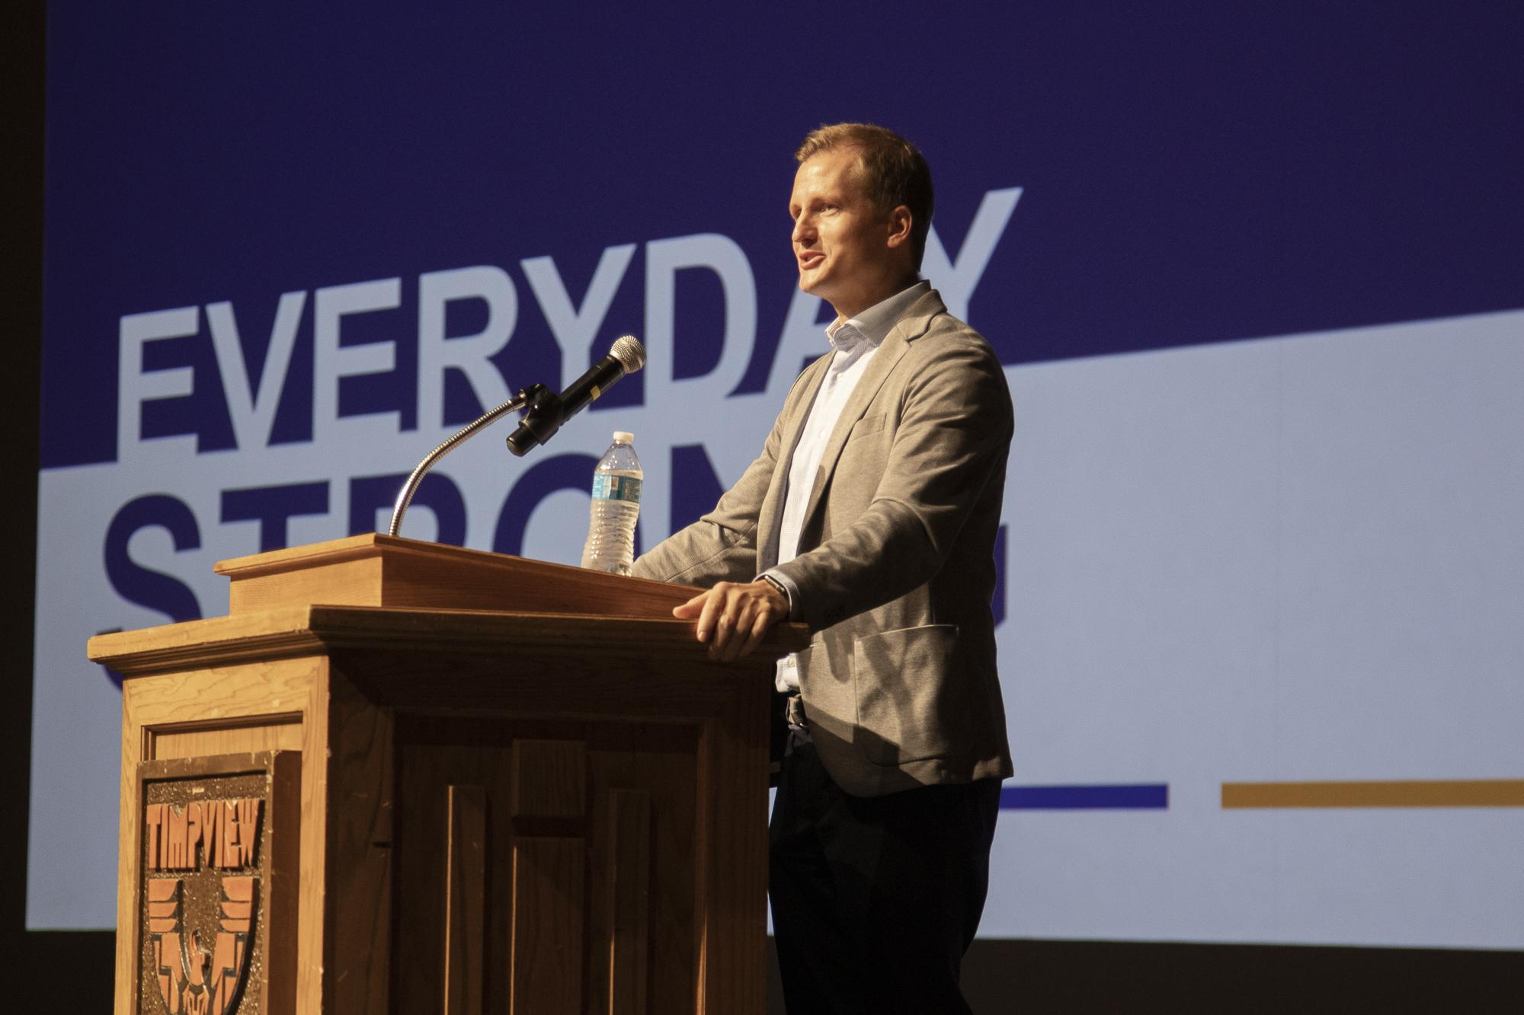

Slide 15
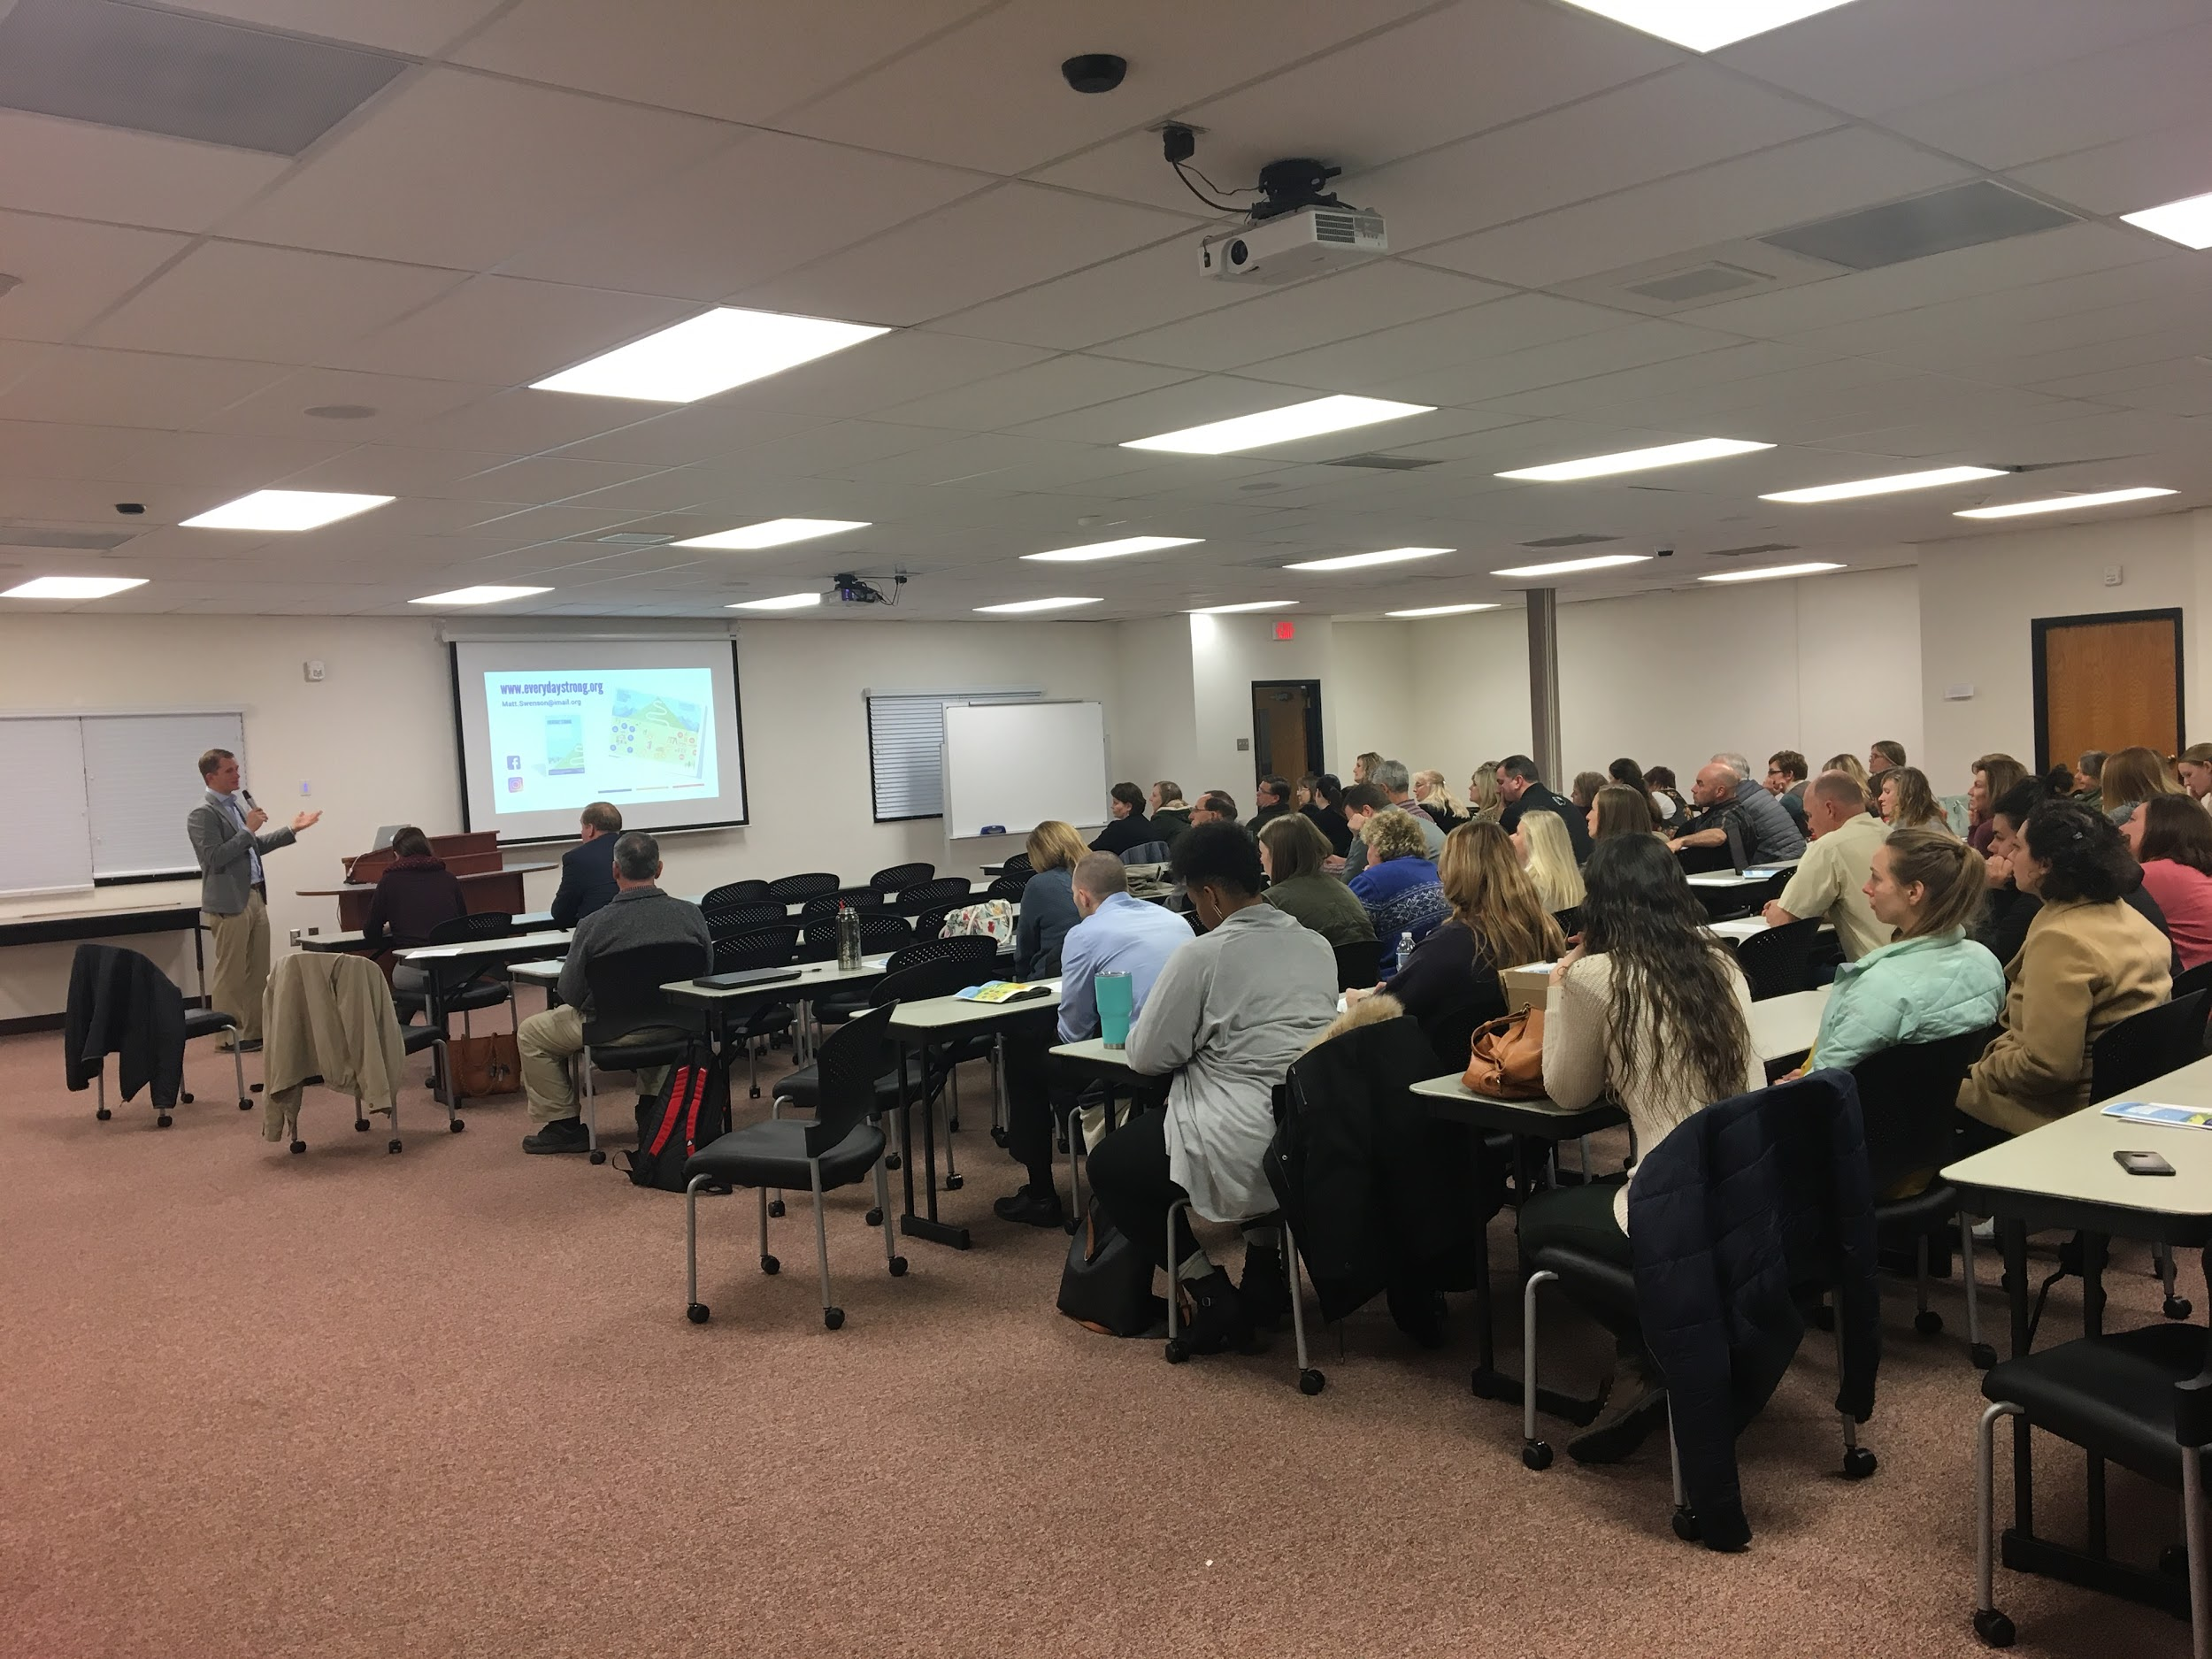

Slide 16
Jordan School District

Slide 18
Summit Academy (Riverton)

Slide 19
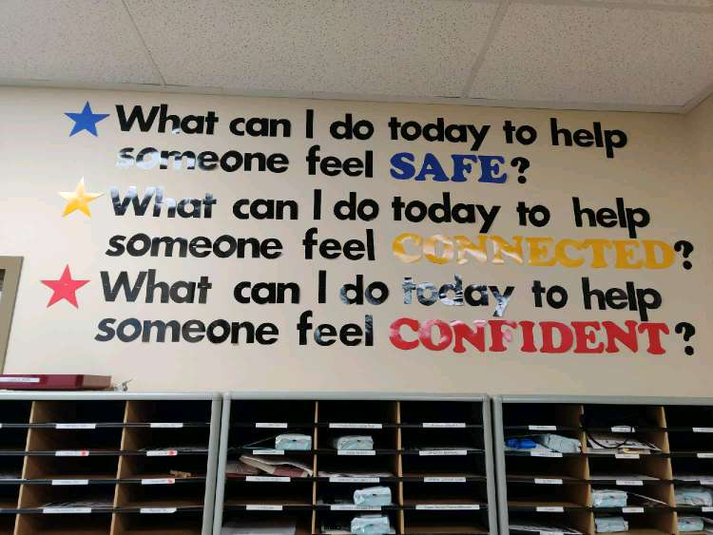

Slide 20
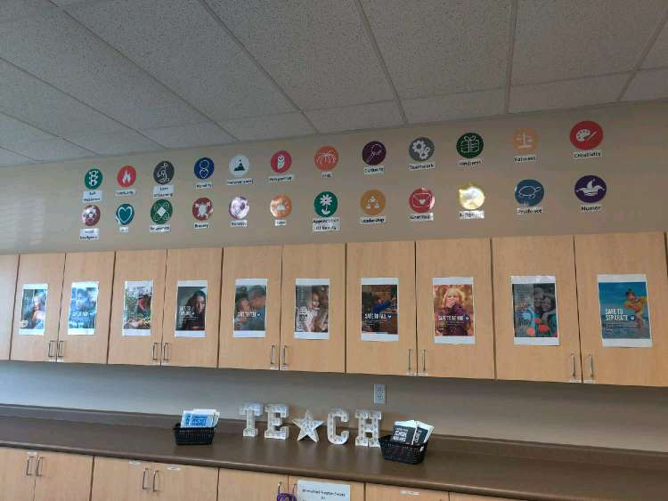

Slide 21
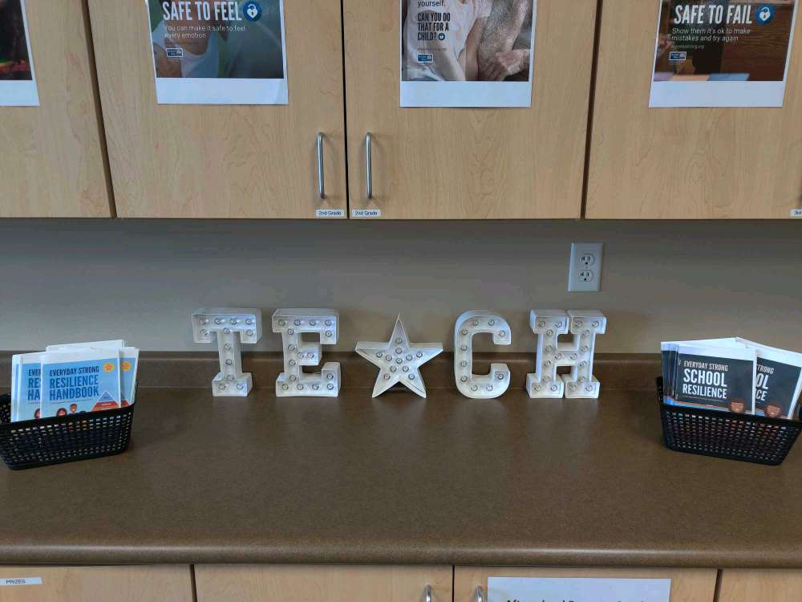

Slide 22
Clearfield Elementary

Slide 24
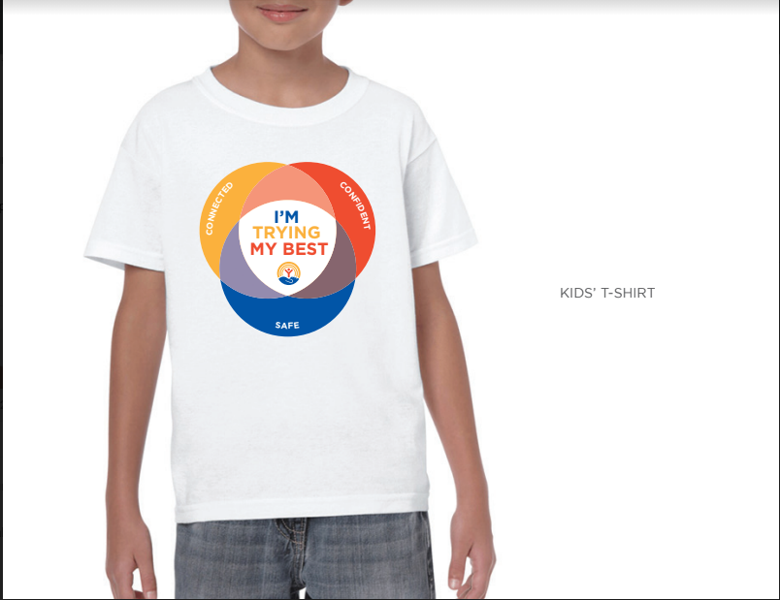

Slide 25
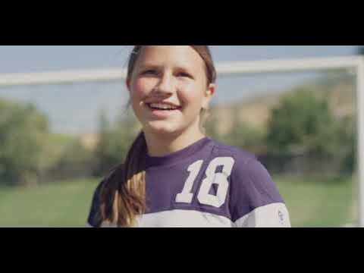
Notes:
Purpose of this slide: to help the audience feel what anxiety or depression feels like and what it feels like, in contrast, when kids feel safe, connected, and confident.
Zoom protocol: to share the video, you’ll need to hover over the green Zoom bar that says “you are screen sharing.” Then go to “more” and hit “optimize share for full screen video clip.” This will share the sound and remove the other participant’s videos temporarily. (Just make sure to “uncheck” this when you’re done!)
Here’s the YouTube link if the embedded video doesn’t work:
https://www.youtube.com/watch?v=yLm6KbH5Wno

Slide 26
“I would love it if parents would ask themselves every day, ‘What can I do to help the children in my life feel safe, connected, and confident? When we meet their needs, we’re building resilient kids.”
- Dr. Matt Swenson, Child Psychiatrist, Intermountain Healthcare; Chair, EveryDay Strong Professional Advisory Council
Notes:
READ the quote. This is the ultimate invitation: to do this every day. The easiest, shortest to-do list.
You can link it back to the quote from the beginning if desired: “When confronted with the fallout of childhood trauma, why do some children adapt and overcome, while others bear lifelong scars that flatten their potential? A growing body of evidence points to one common answer: Every child who winds up doing well has had at least one stable and committed relationship with a supportive adult.”
Safety, connection, and confidence are how you can be that supportive adult.

Slide 27
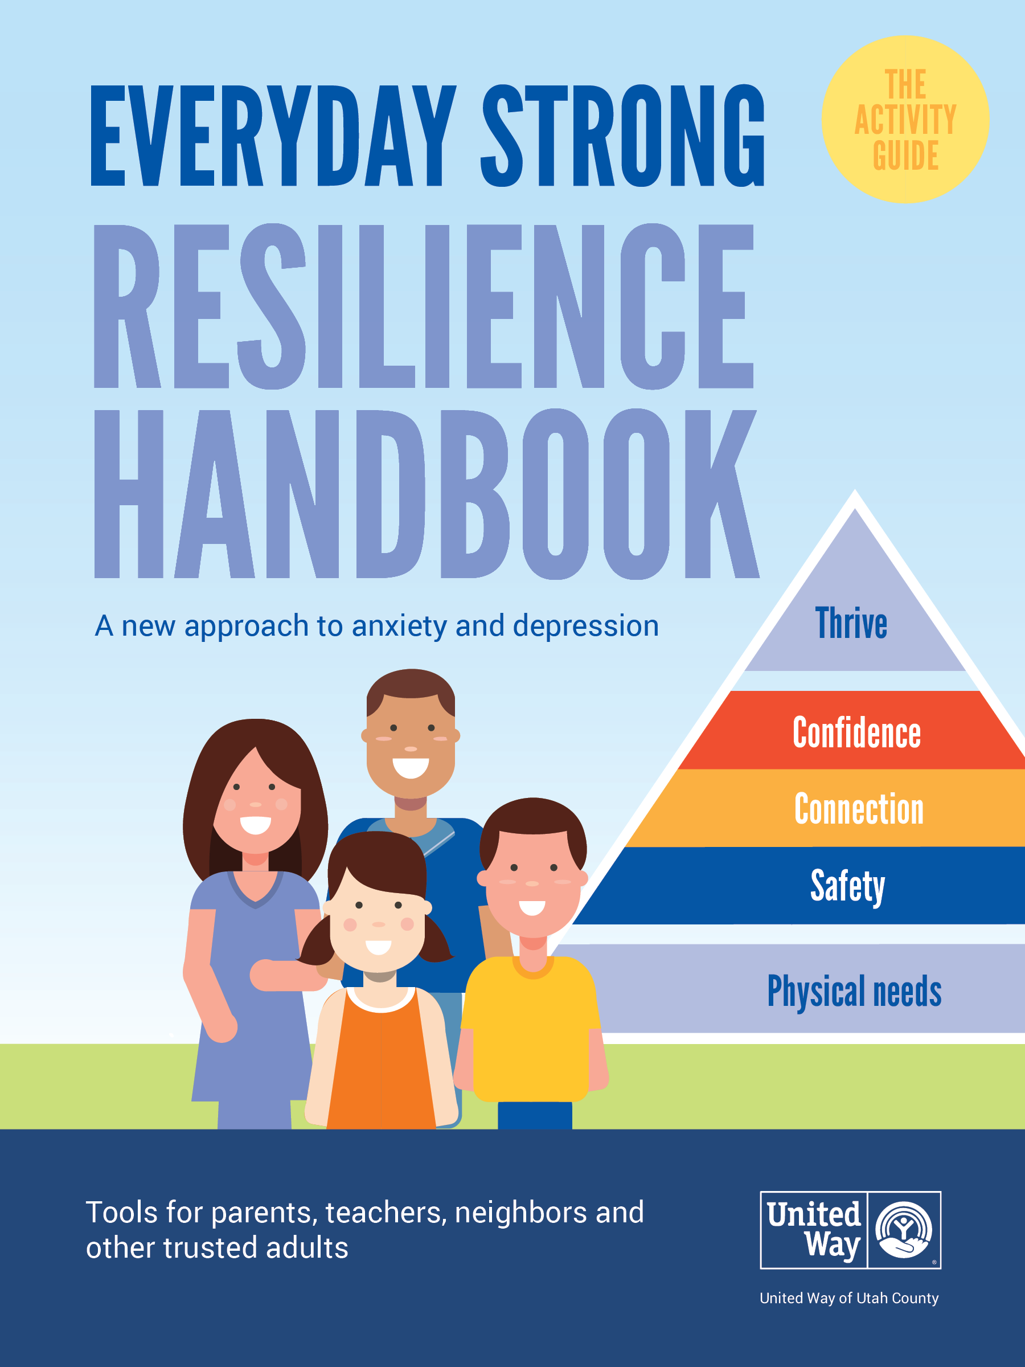
Sign up to be the first to be notified + receive a digital goody bag
uwayuc.org/Waitlist
Notes:
Ally applications are currently closed but will be open in spring 2021.

Slide 28
michaelanng@unitedwayuc.org
801-691-5336
EveryDayStrong.org

