Slide 1
Board Member to Board Member Relationship: Better, Stronger, Together
An INSIDE OUT look at how our behavior and relationships with each other, both inside and outside the board room, impact the overall effectiveness of our board work, ultimately impacting student achievement
Linda Hanks, USBA President-Elect (Juab School Board Member)
Brigit Gerrard, USBA Vice-President (Davis School Board Member)

Slide 2
”Inside Out Leadership”
Introduction
Notes:
Becoming a better board member has a lot to do with controlling emotions. Recognize that we all have all these emotions and sometimes one emotion may dominate and it’s our responsibility to control those emotions.

Slide 3
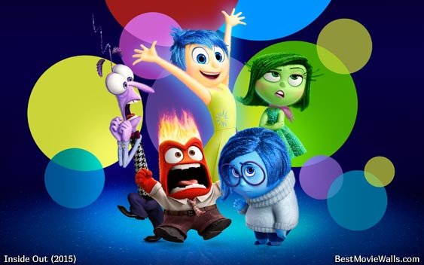
Objectives
INSIDE OUT look at our own behavior and how it may be impacting the overall effectiveness of a board.
Group work looking at 3 scenarios
Resource: “How NOT to be a Terrible School Board Member” by Richard E. Mayer
Discussion
Identify at least one area of improvement

Slide 4
6-10 minute Group Work
Small Group Activity Work
We will look at 3 “terrible habits” that have a negative impact on our relationships with one-another and impact the relationship we have with our superintendent as well as our effectiveness as a board
You need to select a reader and a spokesperson
The reader will read the scenario and lead the group in a discussion about possible solutions to the scenario given (6-7 minutes)
At a given time the presenters will tell the full group about your scenario as well as the better solution (2-4 minutes)

Slide 5
Terrible Habit: Disrespecting a Fellow Board Member
Cultivate an Atmosphere of Mutual Respect.
Respect is reflected in the way you listen and speak
Recognize the respect: “We may not always agree on every issue, but we can recognize that we’re all just trying to do what is best for all kids.”
Difference between what you say and how you say it.
How do consensus and respect work together.
Staying in control of your emotions will help build mutual respect.
MUTUAL RESPECT among board members is a FRAGILE but PRICELESS asset that YOU should work HARD to maintain

Slide 6
Terrible Habit: Building Coalitions Meetings outside the meetings
Conduct the Public’s Business in PUBLIC
Working Premise: the public deserves to know what board members think and to see the board’s decision-making process in action.
Consider the implication of your coalition-building activity for the board to function as a team.
It’s one thing to stand in the parking lot after a meeting and discuss your upcoming vacation or the well-being of a family member, it’s quite another to ask what it would take for a fellow board member to vote your way on an upcoming issue.

Slide 7
Terrible Habit: Doing too much homework conducting your own investigations
Follow the PROCESS – Don’t start with the product
Decision-Making Process
Board establishes a clear statement of the issue
Superintendent is generally responsible for communicating to the board relevant/requested information
Board members
Study the relevant information
Direct questions to the superintendent to fully understand
Listen to input from the public, district employees, etc.
Discuss at board meetings or working groups
The Superintendent (or management team) is responsible for drafting policies/recommendations consistent with the board’s direction
The Board is then responsible for accepting, revising, replacing, or rejecting the draft policies/recommendation.
The Decision-Making Process requires a team effort: time, effort, compromise, listening and discussion.

Slide 8
What Successful board members do
Listen to constituents and share concerns with the whole board
Help constituents understand the proper process to resolve problems
Are accessible to the community
Remember that they are elected locally, but are responsible for the entire School District
Work issues and concerns through the Superintendent, not directly with staff
Seek constant improvement in student achievement
Support all Board decisions
Keep confidential matters confidential
Remember an individual Board member has no authority
Refrain from promoting a personal agenda
Publicize the great things happening in the School District
Develop a cohesive team with Board, Superintendent, Business Administrator & District Staff
MUTUAL RESPECT
EMOTIONS in check

Slide 9
Final Thoughts

