Slide 1

From an idea, to a story, to Utah Statute
Working effectively with legislators

Slide 2
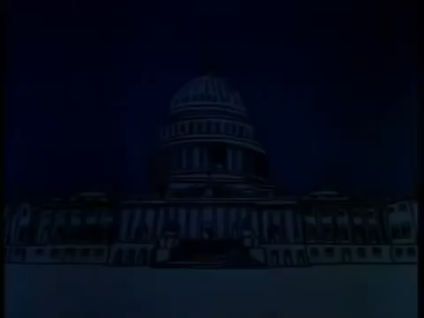

Slide 3
From an idea, to a story, to Utah Statute
Working effectively with legislators

Slide 4
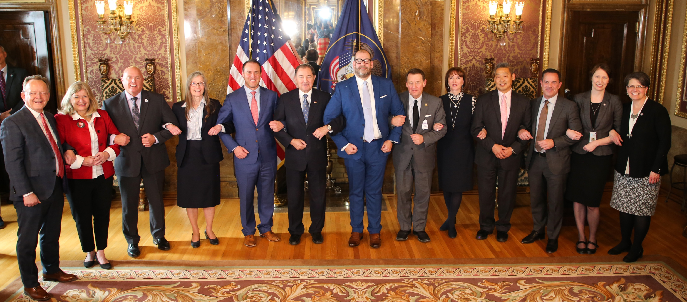
Lesson 1-
Relationships are everything.

Slide 5

Lead with gratitude then ask good questions.
Don’t start a debate
Genuinely seek information
Genuinely seek to understand
Genuinely listen

Slide 6
Be prepared for the conversation
Know the good
Know the bad

Slide 7
Be prepared for the conversation

Slide 8
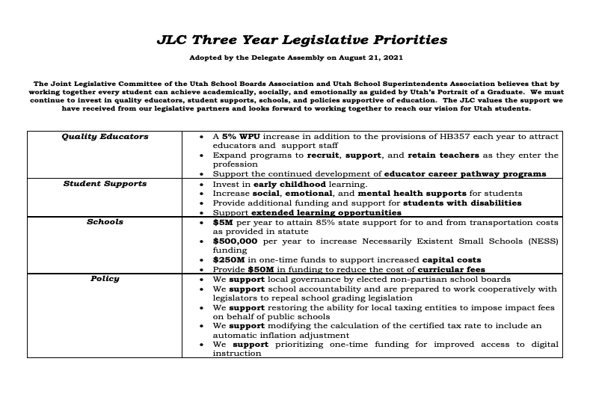
Be prepared for the conversation

Slide 9
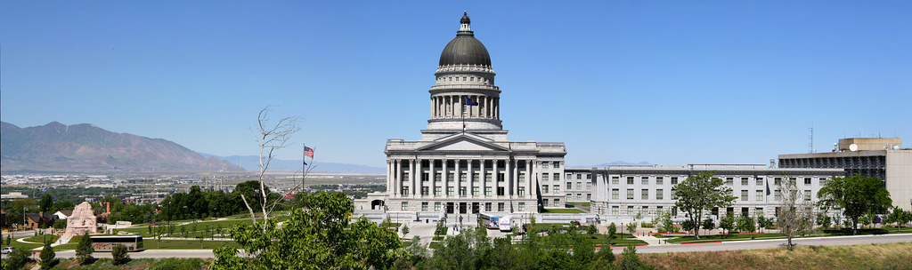
Lesson 2 –
Know the process.
Where it starts
Where it goes
Where to find out

Slide 10

Everything starts with an idea… and a story.

Slide 11
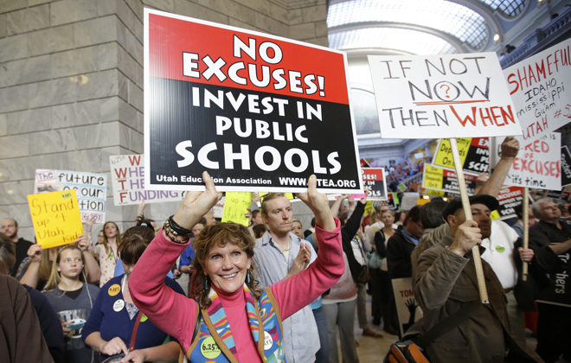

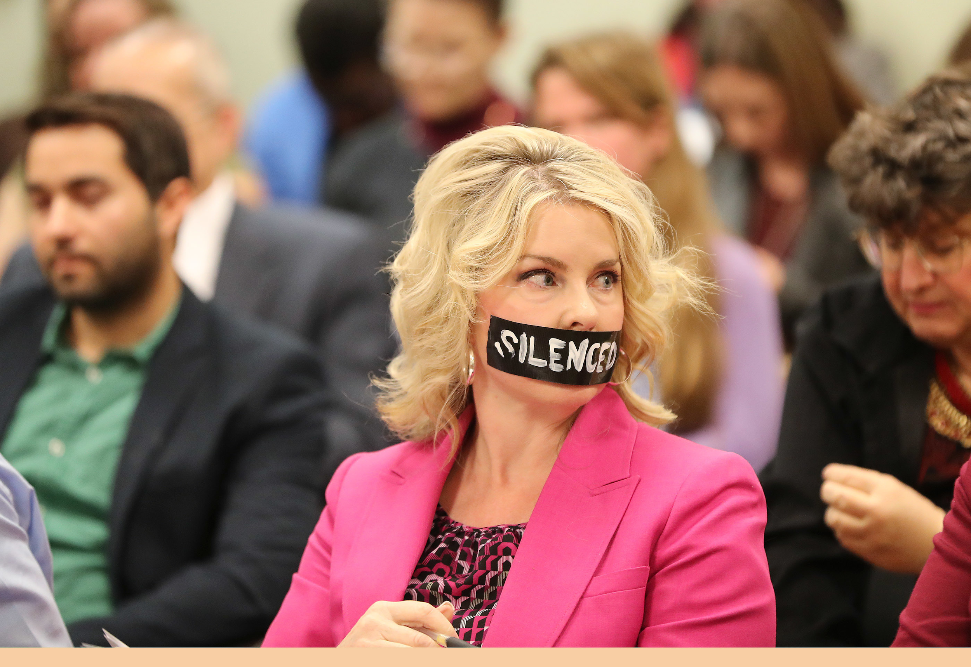
Who tells the story?

Slide 12
Bill formulation and drafting
Ideas are given to legislative drafting attorneys
A bill file is created
The bill request is placed on the public site
The bill is given a number

Slide 13
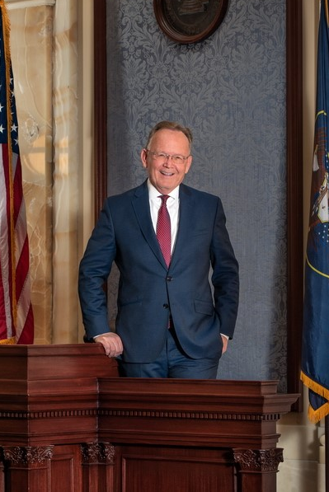
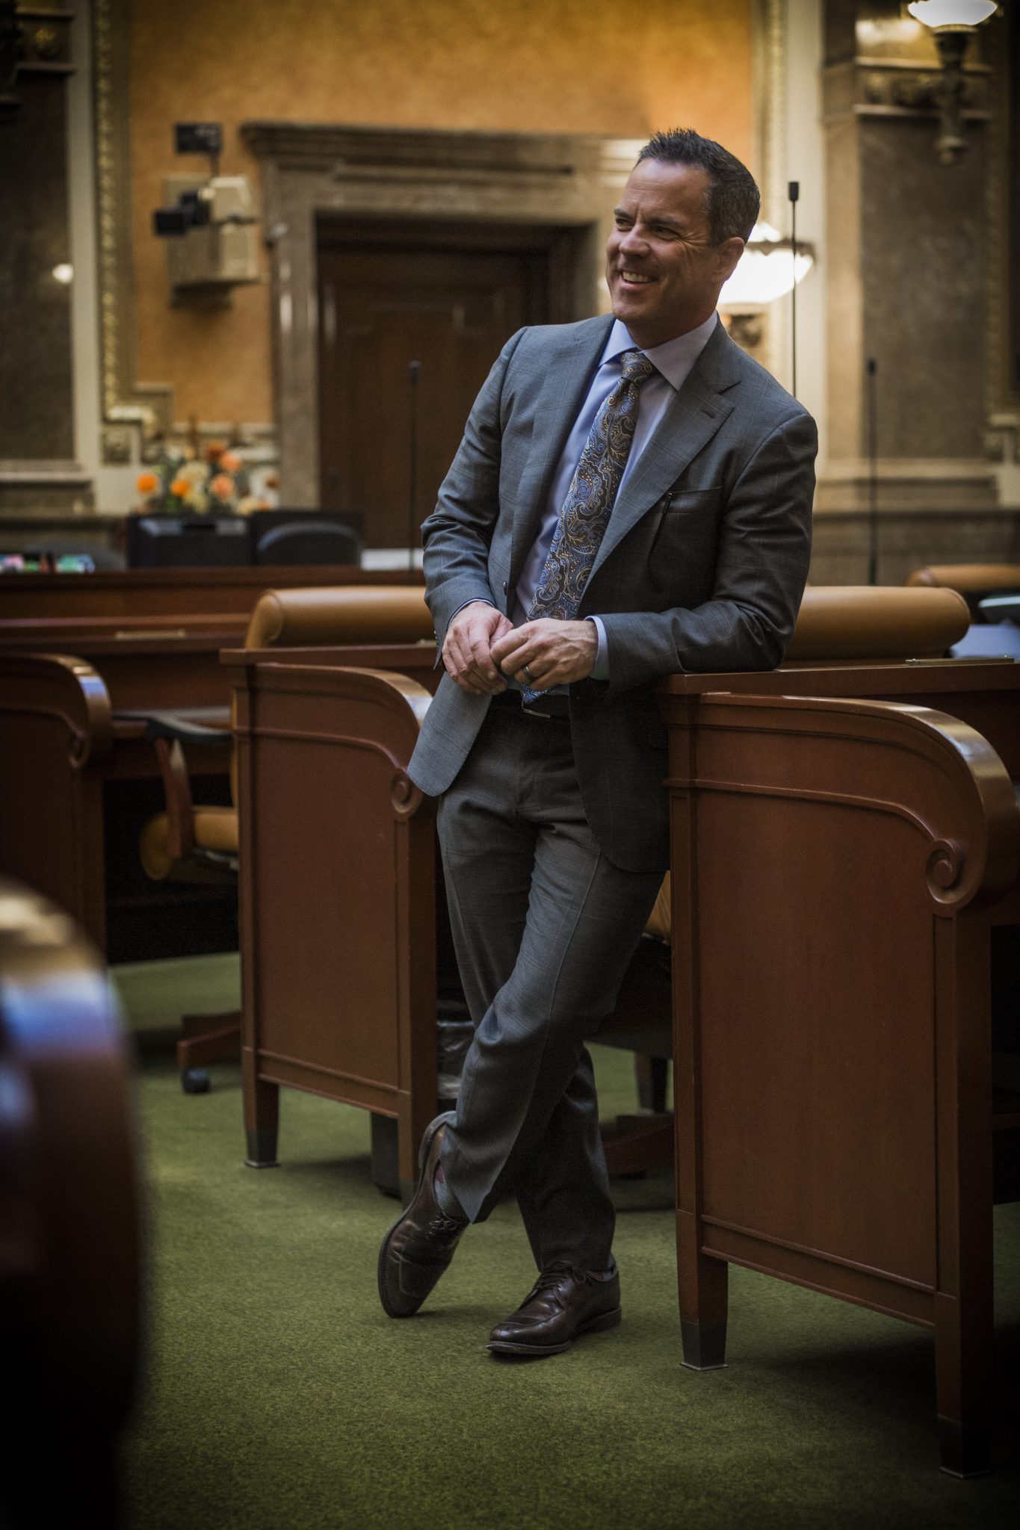
It helps to know who’s in charge

Slide 14
The Legislative Process (by the book)
Rules Committee (bill is introduced) and assigned to a committee
Standing Committee Discussion, Debate, Recommended (or not)
Heard by the full House or Senate (finalized on Second or Third Readings)
Sent to the rules committee of the other legislative body and assigned committee
Heard and voted on by the other legislative body’s committee
Heard by the other full body (finalized on Second or Third Readings)
  *At any time in committee or on the floor a bill may be amended or substituted
  Legislators may request a bill be delayed for action (called circling the bill with the full body or asking a committee chair to delay the hearing) to allow time to seek support or make sure key votes are present
Passing both bodies, the bill is enrolled and sent to the Governor
Governor may choose to sign, ignore signing, or veto the legislation
Veto override requires a two-thirds majority
Becomes law 60 days after session ends or on specific date in the legislation

Slide 15
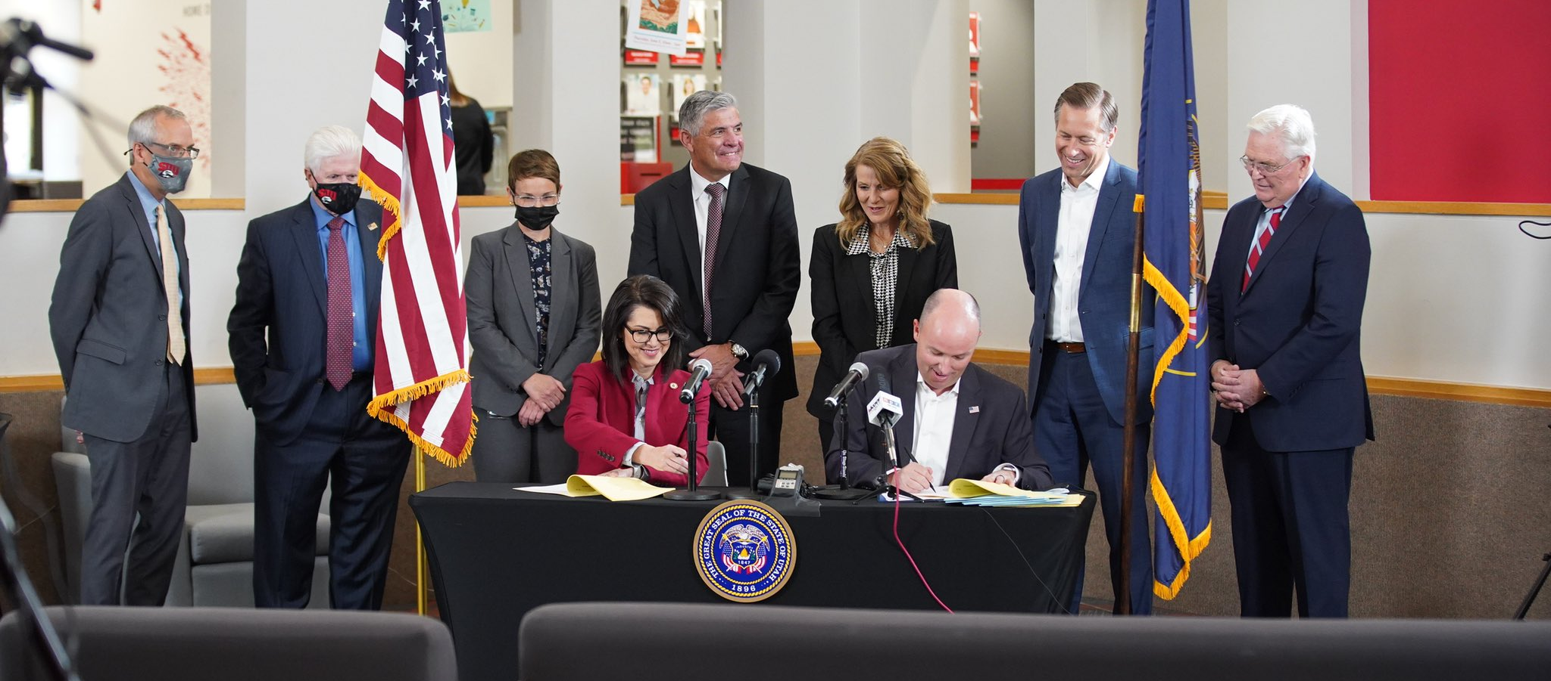
36 – 15 –1

Slide 16
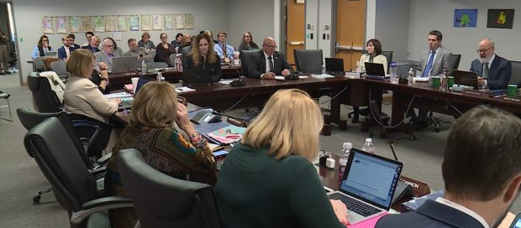
Utah State Board of Education Rule Making R277….

Slide 17
Best Practices: The Politics of Politics
Presence… and not just at the capital
Get to know your legislators outside of the legislative session
Promote positive efforts
Get them in your schools
Ask questions and listen
Earn their trust, be their go-to person
Tell a compelling story

Slide 18
QUESTIONS?

