Slide 1
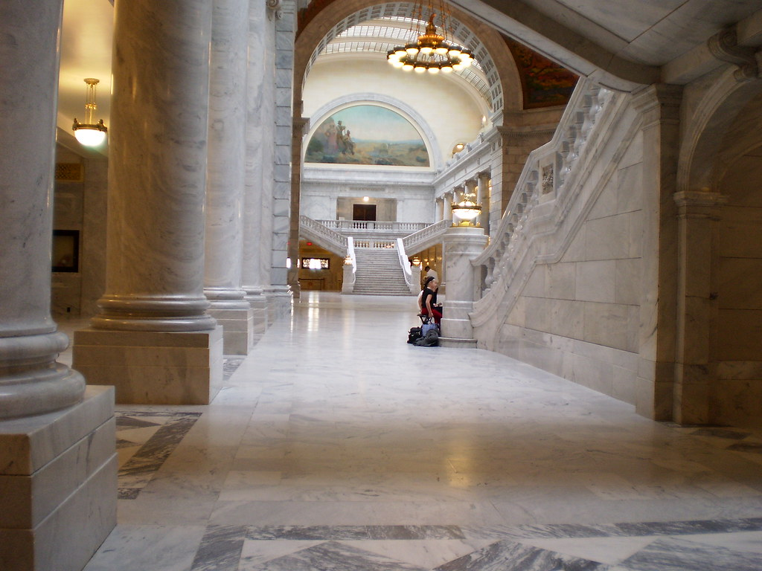
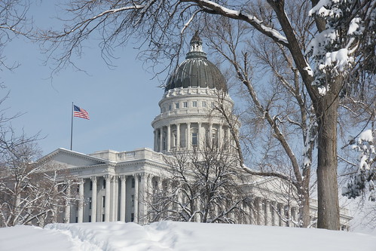
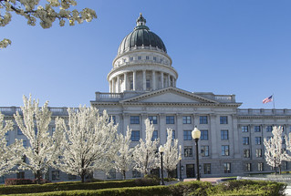
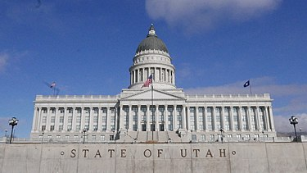
Proactive Legislative Work
Linda Hanks & Lexi Cunningham
September 8, 2023

Slide 2
ADVOCATE
noun
a person who publicly supports or recommends a particular cause or policy
"he was an untiring advocate of economic reform"
verb
publicly recommend or support
"they advocated an ethical foreign policy"
synonyms
supporter, promoter, champion, booster, expounder, true believer, backer

Slide 3
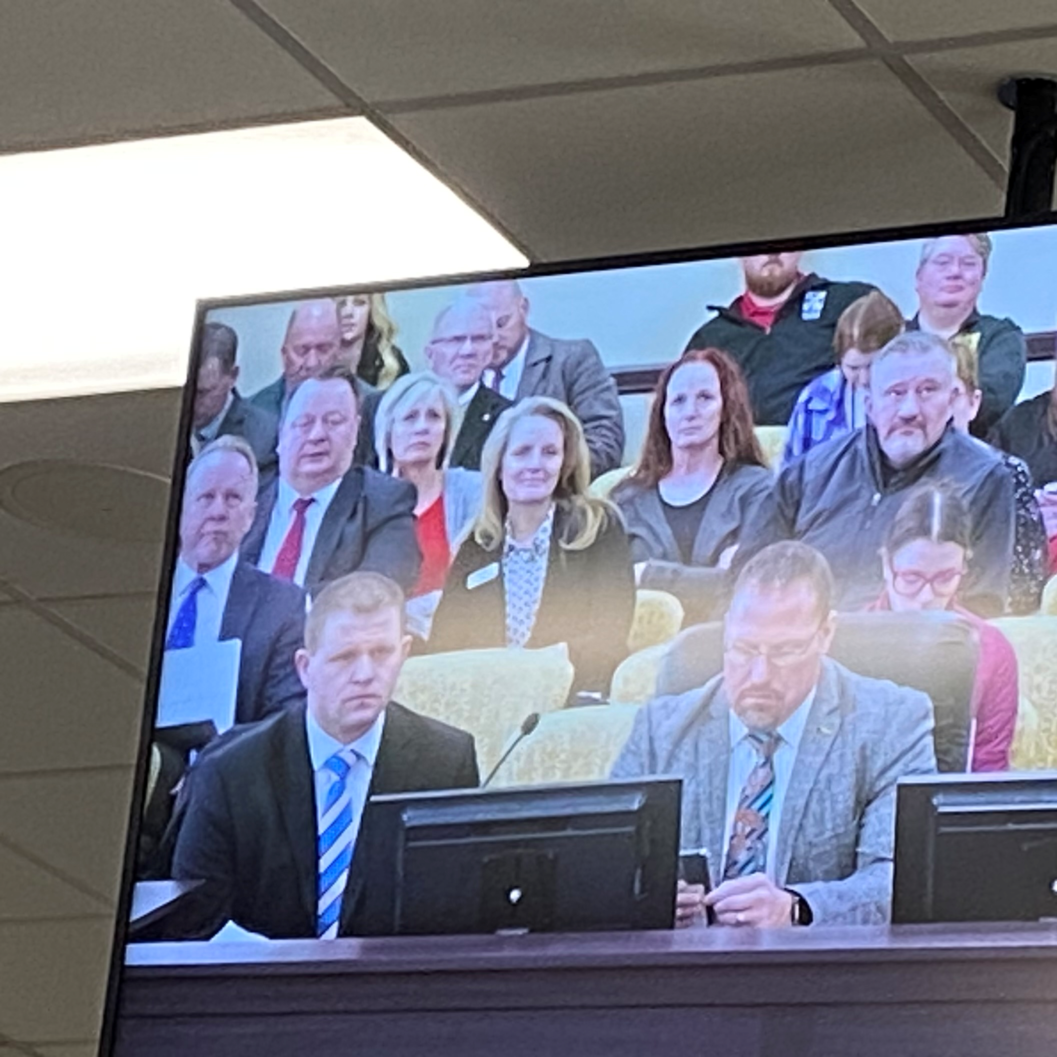
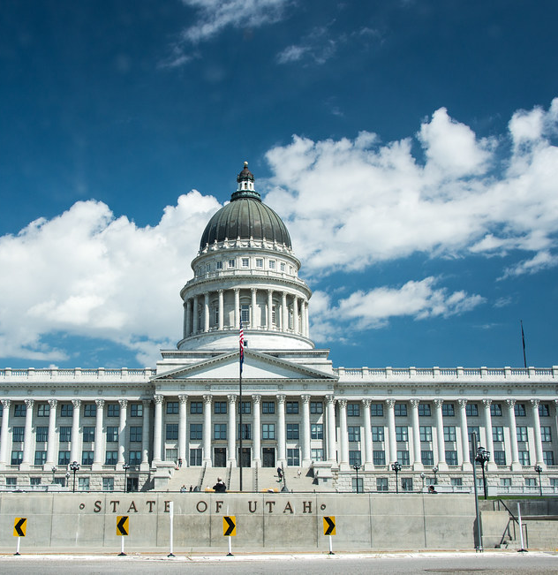
How we communicate matters…..
Be clear, concise & concrete
Be confident
Listen carefully to others
Ask questions
Use stories to communicate

Slide 4
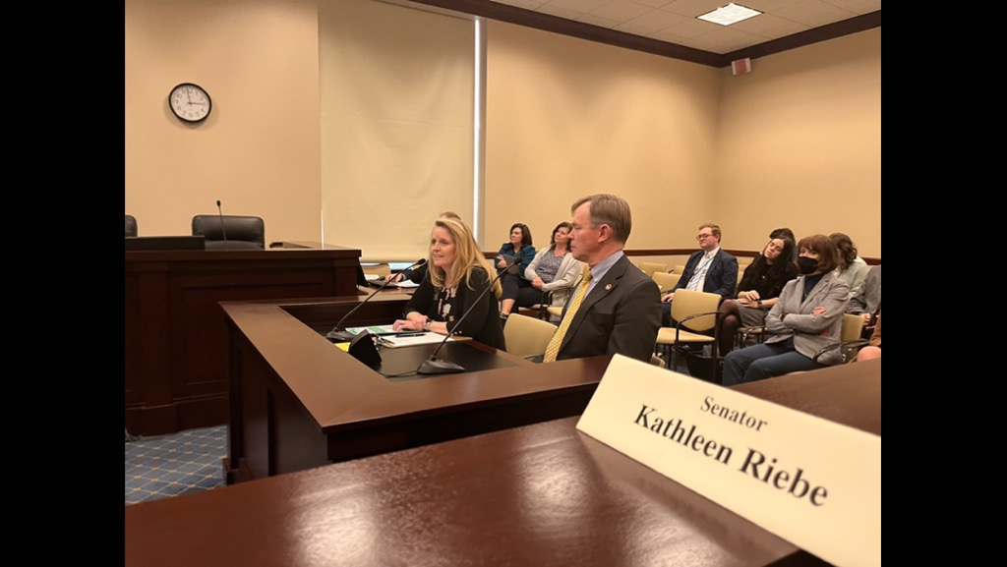
Who do I communicate with?
How do I find my legislator
Utah State Legislative District Maps
How do I contact my legislator?
Senate Roster
House Roster
What opportunities do I have to interact with my legislator?

Slide 5
Timeline, Committees & Session
Important Dates
Interim Committees
Legislative Session

Slide 6
How do I advocate?
1
Relationships, Relationships, Relationships
2
Board, Superintendent, Business Administrator Team
3
What’s your story?

Slide 7
How do I better advocate for public education?
JLC Meetings & Updates
Call to Action
Be Present

Slide 8
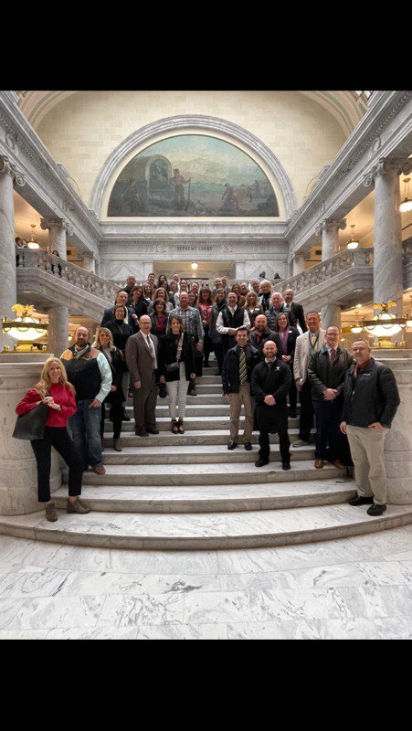
Questions?

Slide 9
Thank you!

