Slide 1

Some things I’ve learned
C. Shane Reese
President, Brigham Young University

Slide 2
Questions
(and yes, I’m going to be annoying and ask you to raise your hand)

Slide 3
Who traveled more than 20 miles to attend this evening?

Slide 4
Who has been in their role on the school board for less than 1 year?

Slide 5
Who is fully confident in every decision your board made in the last 6 months?

Slide 6
Who has rural schools as part of the school district you represent?

Slide 7
Who is an optimist about education?

Slide 8
Who cares deeply about the education of the young people in Utah?

Slide 9
Some things I’ve learned
We have more in common than differences on the things that matter most about our primary purpose.
Mission matters.
Trust in education has eroded, but not beyond repair.
Success depends critically on the premise that all we do must begin and end with students.

Slide 10
We have more in common than differences on the things that matter most about our primary purpose.
Higher lifetime earnings
Higher civic and community engagement
Friendships and social networks
Deepened appreciation for different perspectives and people
Ability to build and lift others
Capacity to serve in our communities
Deepened character

Slide 11
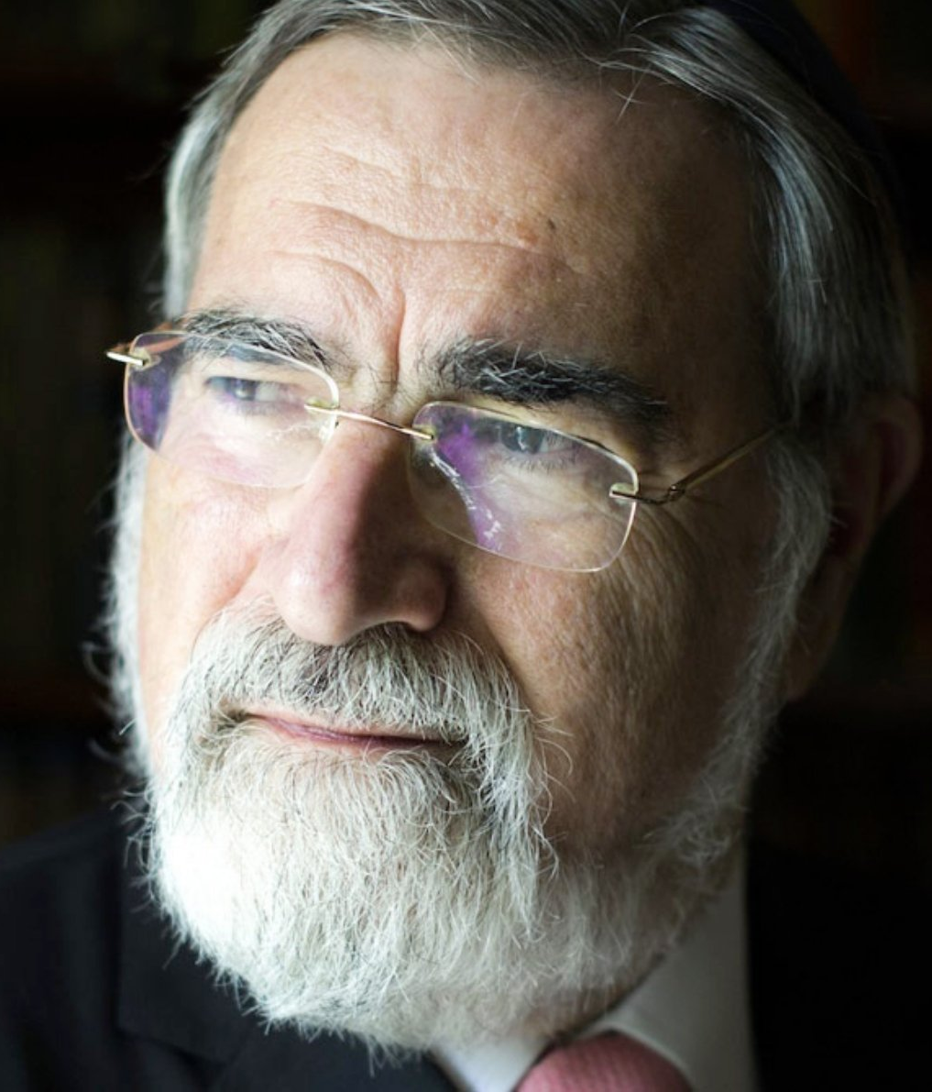
“Self-interest generates contracts. In a contract, two or more individuals, each pursuing their own advantage, come together to make an exchange for mutual benefit. I pay my garage mechanic to mend my car. I and others pay our taxes to ensure that we have the social services we need. So there is the commercial contract that creates the market, and the social contract that creates the state … the motivating factor is self-interest. Contracts are about ‘I.’ … A covenant generates a different kind of relationship altogether. Recall that what makes it different is that in a covenant, two or more individuals, each respecting the dignity and integrity of the other, come together in a bond …of trust, to share their interests, sometimes even to share their lives, by pledging their faithfulness to one another, to do together what neither can achieve alone. Unlike contracts, which are entered into for the sake of advantage, covenants are moral commitments sustained by loyalty and fidelity, even when they call for sacrifice. They are about you and I coming together to form a ’We.’”

Slide 12
Mission matters
Strengthening the Student Experience
Retaining and Strengthening a Focus on Undergraduate Teaching
Reinforcing our “Dual Heritage,” or being Bilingual, for Faculty, Staff, and Students
Developing the Courage to Be Different
Building a Community of Belonging
Investing in Mission-Inspired Scholarship
Focusing on Mission-Aligned Hiring

Slide 13
Eroding Trust in Education
Gordon Gee – “we are in this together”
Avoid distractions: focus on our primary task -- education
Student centricity is key

Slide 14
It must begin and end with students
Epidemic of loneliness
Hire personnel (faculty and staff) who are committed to, or willing to learn to be student-centric.
Gallup study: Characteristics of faculty who led to odds of graduates being engaged at work more than doubled, as did their odds of thriving in their well-being.
  who cared about them as a person
  made them excited about learning
  encouraged them to pursue their dreams

Slide 15
We are in this together
We have more in common than differences on the things that matter most about our primary purpose.
Mission matters
Trust in education has eroded, but not beyond repair.
Success depends critically on the premise that all we do must begin and end with students.

